Slide 1
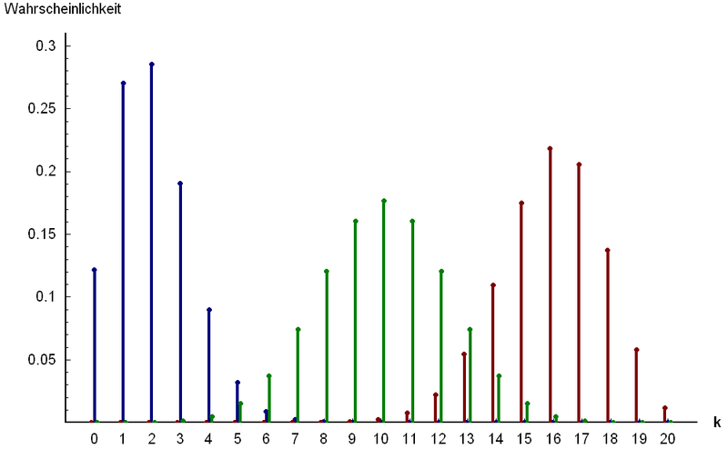
Part 2: Named Discrete Random Variables
http://www.answers.com/topic/binomial-distribution

Slide 2
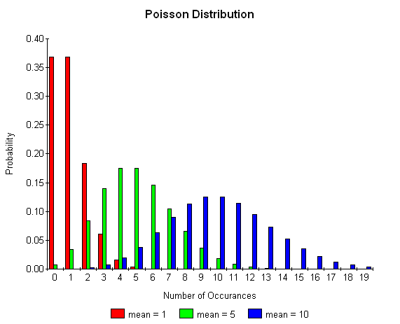
Chapter 18: Poisson Random Variables
http://www.boost.org/doc/libs/1_35_0/libs/math/doc/sf_and_dist/html
/math_toolkit/dist/dist_ref/dists/poisson_dist.html

Slide 3
Examples of Poisson R.V.’s
The number of patients that arrive in an emergency room (or any other location) between 6:00 pm and 7:00 pm (or any other period of time) with a rate of 5 per hour.
The number of alpha particles emitted per minute by a radioactive substance with a rate of 10 per minute.
The number of cars that are located on a particular section of highway at a given time with an average value of 7 per mile .

Slide 4
Examples of Poisson R.V. (extension)
The number of misprints on a page of a book.
The number of people in a community living to 100 years of age.
The number of wrong telephone numbers that are dialed in a day.
The number of packages of cat treats sold in a particular store each day.
The number of vacancies occurring during a year in the Supreme Court.

Slide 5
Poisson distribution: Summary
Things to look for: BIS*
Variable: X = # of successes during the specified ‘period’
Parameters:
λ = the average rate of events
Mass:
$P\left(X = x\right)=\frac{e^{−λ}λ^{x}}{x!}, x =0,1, …$
$𝔼$(X) = λ
Var(X) = λ

Slide 6
Example: Poisson Distribution (class)
In any one hour period, the average number of phone calls per minute coming into the switchboard of a company is 2.5.
a) Why is this story a Poisson situation? What is its parameter?
b) What is the probability that exactly 2 phone calls are received in the next hour?
c) Given that at least 1 phone call is received in the next hour, what is the probability that more than 3 are received?
d) *What does the mass look like in this situation?
e) *What does the CDF look like in this situation?

Slide 7
Shapes of Poisson

Slide 8
Example: Poisson Distribution
In any one hour period, the average number of phone calls per minute coming into the switchboard of a company is 2.5.
What is the probability that there will be exactly 6 phone calls in the next 2 hours?
How many phone calls do you expect in the next 2 hours?
What is the probability that there will exactly 6 phone calls in one out of the next three 2-hour time intervals?

Slide 9
Example: Poisson Distribution (2) - Class
Every second on average, 5 neutrons, 3 gamma particles and 6 neutrinos hit the Earth in a certain location.
Why is this story a Poisson situation?
What is the expected number of particles to hit the Earth in that location in the next 5 seconds?
What is the probability that exactly 20 particles will hit the Earth at that location in the next 2 seconds?
What is the probability that exactly 20 particles will hit the Earth at that location tomorrow from 1 pm to 1:00:02 (2 seconds after 1 pm)?

Slide 10
Examples of Poisson R.V. (extension) - class
For each of the following, is n large and p small?
The number of misprints on a page of a book.
The number of people in a community living to 100 years of age.
The number of wrong telephone numbers that are dialed in a day.
The number of packages of cat treats sold in a particular store each day.
The number of vacancies occurring during a year in the Supreme Court.

Slide 11
Example: Poisson Approximation to a Binomial - class
On my page of notes, I have 2150 characters. Say that the chance of a typo (after I proof it) is 0.001.
Is the Poisson approximation to the binomial appropriate?
What is the probability of exactly 3 typos on this page?
What is the probability of at most 3 typos?

Slide 12
Poisson vs. Binomial
P(X = x) | Binomial | Poisson
0 | 0.11636 | 0.11648
1 | 0.25042 | 0.25044
2 | 0.26935 | 0.26922
3 | 0.19305 | 0.19294
4 | 0.10372 | 0.10371
5 | 0.04456 | 0.04459
6 | 0.01595 | 0.01598
7 | 0.00489 | 0.00491
8 | 0.00131 | 0.00132
9 | 0.00031 | 0.00032

Slide 13
Poisson vs. Bionomial

