Slide 1
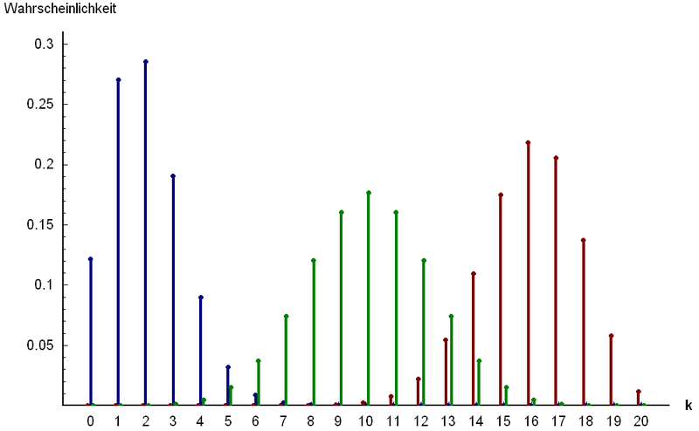
Part 2: Named Discrete Random Variables
http://www.answers.com/topic/binomial-distribution

Slide 2
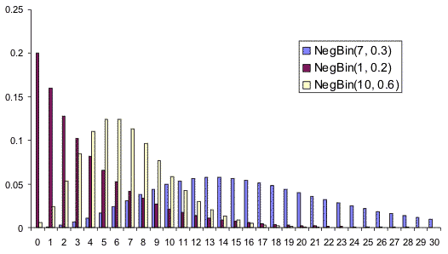
Chapter 17: Negative Binomial Random Variables
http://www.vosesoftware.com/ModelRiskHelp/index.htm#Distributions
/Discrete_distributions/Negative_Binomial.htm

Slide 3
Negative Binomial distribution: Summary
Things to look for: BIS
Variable: X = # of trials until the r^{th} success (r ≤ X)
Parameters:
r = the desired number of successes
p = P(S) = constant, q = P(F) = 1 – p
Mass:
$P\left(X = x\right)= \left({x−1 \atop r−1}\right)qx_rpr, x =r,r+1, …$
$$𝔼\left(X\right)=\frac{r}{p}$$
$$Var\left(X\right)=\frac{qr}{p^{2}}$$

Slide 4
Example: Negative Binomial r.v.
Suppose that we roll an n-sided die until a '1' is rolled. Let X be the number of times it takes to roll the ninth '1'.
Why is this a Negative Binomial situation?
What are the possible values of x?
What is the PMF of X?
What is the probability that it will take 40 rolls?
What is the expected number of rolls?
What is the standard deviation of the number of rolls?

Slide 5
Comparison: Binomial vs. Negative Binomial
 | Binomial | Negative Binomial
Question | What is the prob. that that you will roll 9 “1’s in the first 40 rolls? | What is the probability that 40th roll will be the 9th ‘1’?
Distribution | X ~ Binomial (n = 40, p = 0.05) | X ~ NegBinomial (r = 9, p = 0.05)
Meaning of X | X = # of successes = 9 | X = # of rolls until the 9th ‘1’
Probabiltiy | $$P\left(X=9\right)=\left({40 \atop 9}\right){0.05}^{9}{0.95}^{31}=1.09×{10}^{−4}$$ | $$P\left(X=40\right)=\left({39 \atop 8}\right){0.05}^{9}{0.95}^{31}=2.45×{10}^{−5}$$

Slide 6
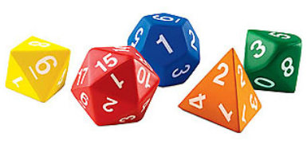
Chapter 20: Discrete Uniform Random Variables
http://www.milefoot.com/math/stat/pdfd-uniformdisc.htm

Slide 7
Discrete Uniform distribution: Summary
Things to look for: equally likelihood situation
Variable: X = the choice of the outcome
Parameters:
N = total number of possible outcomes
Mass:
$P\left(X = x\right)=\frac{1}{N}, x=1, 2, …, N$
$$𝔼\left(X\right)=\frac{N+1}{2}$$
$$Var\left(X\right)=\frac{N^{2}−1}{12}$$

Slide 8
Example: Discrete Uniform (class)
A charitable organization is conducting a raffle in which the grand prize is a new car. Five thousand tickets, numbered 0001, 0002, …, 5000 are sold at $10 each. At the grand-prize drawing, one ticket stub will be selected at random from the 5000 ticket stubs
a) Why is this a Discrete Uniform distribution, and what is the parameter?
b) Explain in words what X is terms of the story? What values can it take on?
c) Suppose that you hold tickets numbered 1003 – 1025. What is the probability that you win the grand prize?
Calculate the following even though they don’t really mean anything.
d) What is the expected value of the winning number?
e) What is the standard deviation?

