Slide 1
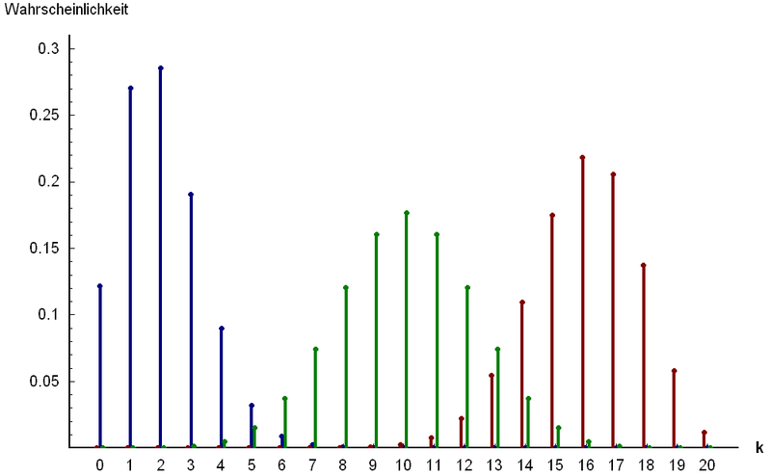
Part 2: Named Discrete Random Variables
http://www.answers.com/topic/binomial-distribution

Slide 2
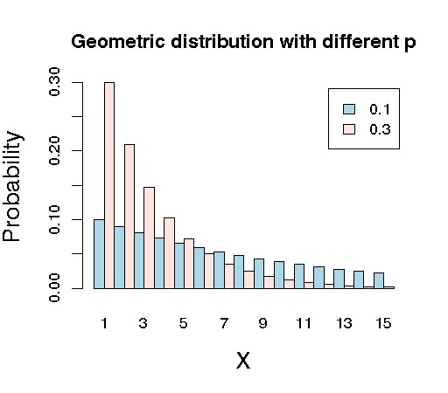
Chapter 16: Geometric Random Variables
http://raven.iab.alaska.edu/~ntakebay/teaching/programming/probability/node8.html

Slide 3
Geometric distribution: Summary
Things to look for: BIS
Variable: X = # of trials until the first success (1 ≤ X)
Parameters:
p = P(S) = constant, q = P(F) = 1 – p
Mass:
P(X = x) = q^{x-1}p, x = 1, 2, 3, …
$$𝔼\left(X\right)=\frac{1}{p}$$
$$Var\left(X\right)=\frac{q}{p^{2}}$$

Slide 4
Example: Geometric Distribution
Suppose that we roll an 20-sided die until a '1' is rolled. Let X be the number of times it takes to roll the '1'.
Why is this a geometric distribution?
What is the PMF of X?
What is the probability that it will take exactly 10 rolls?
If you decide in advance that you will roll the die 10 times, what is the probability that you will have exactly one ‘1’? How is this different from part c)?
What is the expected number of rolls?
What is the standard deviation of the number of rolls?
*What does the mass look like?
*What does the CDF look like?

Slide 5
Shape of Geometric PMF

Slide 6
Example: Geometric r.v. (cont)
Suppose that we roll an 20-sided die until a '1' is rolled. Let X be the number of times it takes to roll the '1'.
What is the probability that it will take no more than 10 rolls?
What is the probability that it will take between 10 and 20 rolls (exclusive)?
Determine the number of rolls so that the person has a 90% or greater chance of rolling a ‘1’?

Slide 7
Example: Geometric r.v. (cont)
Suppose that we roll an 20-sided die until a '1' is rolled. Let X be the number of times it takes to roll the '1'.
What is the probability that it will takes more than 10 rolls to roll the ‘1’?
Assuming that it takes more than 20 rolls to roll the ‘1’. Find the probability that it will take more than 30 rolls to roll the ‘1’?

