Slide 1
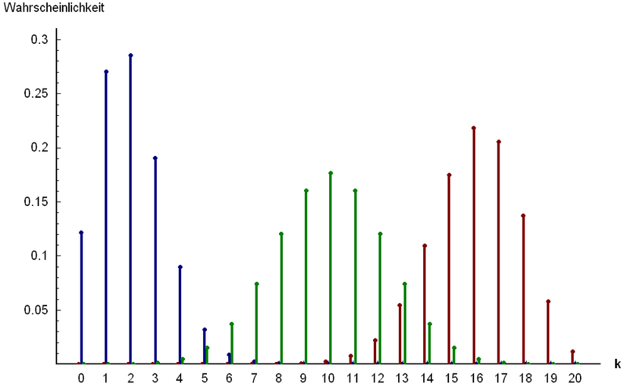
Part 2: Named Discrete Random Variables
http://www.answers.com/topic/binomial-distribution

Slide 2
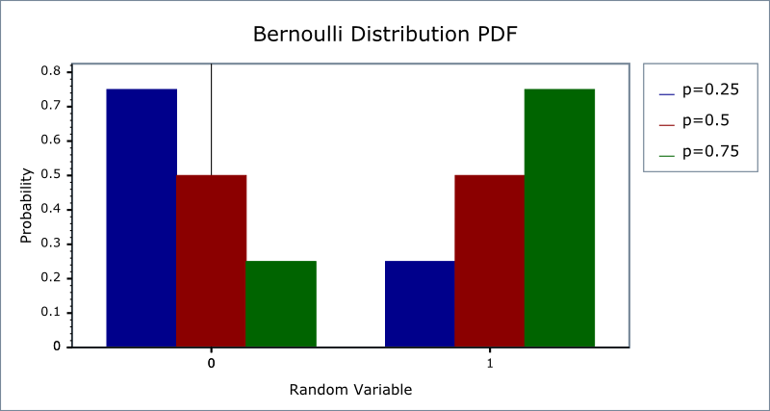
Chapter 14: Bernoulli Random Variables
http://www.boost.org/doc/libs/1_42_0/libs/math/doc/sf_and_dist/html/
math_toolkit/dist/dist_ref/dists/bernoulli_dist.html

Slide 3
Bernoulli distribution: Summary
Things to look for: one trial, success or failure
Variable: $X=\left\{\begin{matrix}0 & outcome is a failure \\ 1 & outcome is a success\end{matrix}\right.$
Parameter:
p = P(S), q = P(F) = 1 – p
Mass:
P(X = 1) = p, P(X = 0) = q
$𝔼$(X) = p
Var(X) = pq

Slide 4
Bernoulli Distribution
Do the following follow a Bernoulli distribution?
If so, a) What is a failure and what is a success? b) Determine p and q, c) Calculate E and Var.
Rolling a fair 4-sided die and observing whether the number showing is a 1 or not.
The number of births of girls in a county hospital on any specific day.
If a patient takes a drug to see if it is effective or not.

Slide 5
Bernoulli Distribution(cont)
In a drug trial, some patients with the same condition are given a drug and some are given a placebo to see if the drug is effective or not.
In quality control we want to see if a particular product is ‘defective’. We take random samples from an assembly line and check each sample to see if the product is defective.
We look at the percentage that a basketball player makes her shots. We want to know how many baskets it takes until she misses a shot.

Slide 6
Bernoulli Distribution(cont)
At a certain point in a card game, if you get spade, you with $4, if you get a 2 (except the 2♠), you lose $5, if you get the A♥, you win $20, and if you get any other card, the game ends with no money being exchanged.
What is your expected gain or loss?
You and 3 friends are playing using the rules above using your own deck. We are interested if a player receives any of the cards listed.
What is the expected value of the number people getting one of the above cards?
What is the variance of the number of people getting one of the above cards?

Slide 7
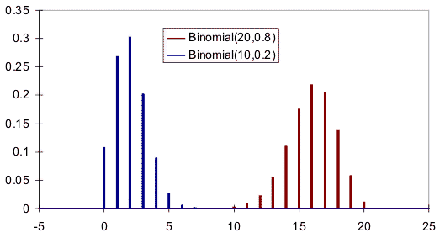
Chapter 15: Binomial Random Variables
http://www.vosesoftware.com/ModelRiskHelp/index.htm#Distributions
/Discrete_distributions/Binomial_distribution.htm

Slide 8
Properties of a Binomial Experiment - BInS
Binary: There are only two possible outcomes for each trial.
Independent: The outcomes of the trials are independent.
n: The experiment consists of n identical trials where n is fixed..
Success: For each trial, the probability p of success must be the same.

Slide 9
Binomial Distribution: Situation
In each case, identify whether the situation is binomial are not. If it is binomial, state what the parameters are, n and p.
Rolling a fair 4-sided die 5 times and observing whether the number showing is a 1 or not.
In quality control we want to see if a particular product is ‘bad’. We take random samples from an assembly line that uses different machines to product the product.
We draw 2 cards from a deck without replacement. We are interested in knowing if the cards are red or not.

Slide 10
Binomial distribution: Summary
Things to look for: BInS
Variable: X = # of success in n trials (0 ≤ X ≤ n)
Parameters:
n: number of trials (n = 1 → Bernoulli)
p = P(S) = constant, q = P(F) = 1 – p
Mass:
$P\left(X=x\right)=\left({n \atop x}\right)p^{x}q^{n−x}, x=0, 1, ⋯, n$
$𝔼$(X) = np
Var(X) = npq

Slide 11
Binomial r.v. (in class)
A restaurant serves eight entrées of fish, 12 of beef, and 10 of poultry. If customers select from these entrées randomly, what is the probability that
a) two of the next four customers order fish entrées?
b) at most one of the next four customers orders fish?
c) at least one of the next four customers orders fish?
d)* How many customers would the restaurant have to serve to be sure that there is a 90% chance that at least one of them orders a fish entrée?
e) What is the expected number of customers (in the next 4 customers) that will order fish?
f) What is the standard deviation of the number of people who order fish?

Slide 12
Shapes of Histograms
Symmetric
Right skewed
Left skewed

Slide 13
g)What is the mass, graph of mass, graph of CDF?
X | 0 | 1 | 2 | 3 | 4 | else
p_{X}(x) | 0.289 | 0.421 | 0.229 | 0.056 | 0.005 | 0

Slide 14
Probability histograms for binomial distributions with different p’s with n = 8
p = 0.2
p = 0.5
p = 0.8

