Slide 1
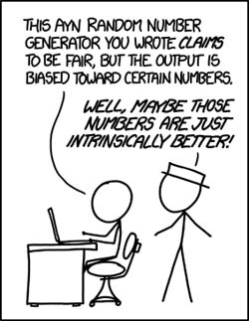
Part II: Discrete Random Variables
http://neveryetmelted.com/categories/mathematics/

Slide 2
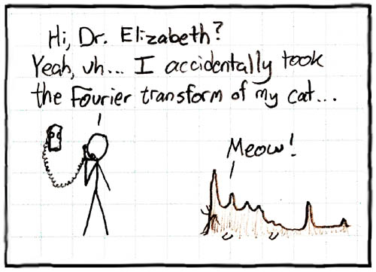
Chapter 7: Random Variables; Discrete Versus Continuous
http://math.sfsu.edu/beck/quotes.html

Slide 3
Example: Random Variable
We are playing a very simplified version of blackjack in which each person is only dealt 2 cards. We are interested in the sum of the cards.
a) is the sum of the cards a quantitative or qualitative variable?
b) Is this a random variable?
c) What is the sample space for this random variable?
d) what are the possible values for the random variable?

Slide 4
Example: Random Variable
The lifetime of a light bulb
The number of students in class on any particular day
The length of time to wait for a bus
The number of seconds it takes for Mosby (one of my cats) to sit on my lap after I sit down in my chair.

Slide 5
Random Variable Discrete: Example
Supposed that you draw 3 cards from a deck of cards and record whether the suit is black or red. Let Y be the total number of red cards.
a) construct a table that shows the values of Y
b) Explain why Y is a discrete random variable
Identify the following events in words and as a subset of the sample space.
c) {Y = 2} d) {Y ≥ 2} e) {Y ≤ 1}

Slide 6
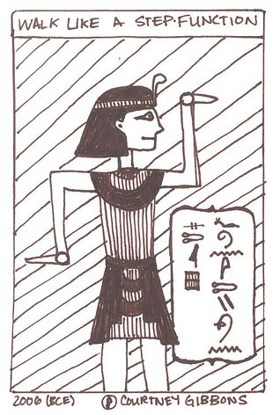
Chapter 8: Probability Mass Functions and Cumulative Distribution Functions
The 50-50-90 rule: Anytime
You have a 50-50 chance of
getting something right,
there’s a 90% probability
you’ll get it wrong.
Andy Rooney
http://brownsharpie.courtneygibbons.org/?p=161

Slide 7
Example: Mass and CDF
Supposed that you draw 3 cards from a deck of cards and record whether the suit is black or red. Let X be the total number of red cards.
What is p_{X}(2)?
Determine the mass of X.
c) Construct a probability plot and histogram for X.
d) What is the CDF of X?
e) Construct a plot of the CDF.

Slide 8
Plots for 3 cards Example

Slide 9
Histogram: interpretation of PMF
Theoretical
Simulated
1000 times
Simulated
10,000 times

Slide 10
Calculation of Probabilities from CDFs
Let X be a random variable. Then for all real numbers a,b where a < b
P(a < X ≤ b) = F_{X}(b) – F_{X}(a)
P(a ≤ X ≤ b) = F_{X}(b) – F_{X}(a-)
P(a < X < b) = F_{X}(b-) – F_{X}(a)
P(a ≤ X < b) = F_{X}(b-) – F_{X}(a-)

Slide 11
Example 1: Coin Flipping
Flip a coin until the first head appears. Let X denote the number of flips until the first head appears (including the head).

Slide 12
Example 1: (cont)
mass
CDF

Slide 13
Example 2: CDF → mass
We want to know the probability that the next car that passes you on the road is blue (1), red (2), silver (3) or some other color (0). However, we misplaced the mass and only kept the CDF. Given the following CDF, what is the mass?
$$F_{X}\left(x\right)=\left\{\begin{matrix}0 & for x≤0 \\ 0.369 & for 0≤x<1 \\ \begin{matrix}0.584 \\ 0.816 \\ 1\end{matrix} & \begin{matrix}for 1≤x<2 \\ for 2≤x<3 \\ for 03≤x\end{matrix}\end{matrix}\right.$$

Slide 14
PMF: Example
Supposed that you draw 3 cards from a deck of cards (with replacement) and record whether the suit is black or red. Let Y be the total number of red cards.
Determine the PMF when
there are equal numbers of red and black cards.
if out of 100 cards, 30 are red and 70 are black.
for p red cards out of 100 cards.

Slide 15
PMF Example (cont)
Outcome | Probability
 | p = 0.5 | p = 0.3 | General p
RRR
RRB
RBR
RBB
BRR
BRB
BBR
BBB

Slide 16
PMF Example (cont)
Outcome | Probability
 | p = 0.5 | p = 0.3 | General p
RRR | 1/8 = 0.125
RRB
RBR
RBB
BRR
BRB
BBR
BBB

Slide 17
PMF Example (cont)
Outcome | Probability
 | p = 0.5 | p = 0.3 | General p
RRR | 1/8 = 0.125 | 0.027
RRB
RBR
RBB
BRR
BRB
BBR
BBB

Slide 18
PMF Example (cont)
Outcome | Probability
 | p = 0.5 | p = 0.3 | General p
RRR | 1/8 = 0.125 | 0.027 | p³(1 – p)⁰
RRB
RBR
RBB
BRR
BRB
BBR
BBB

Slide 19
PMF Example (cont)
Outcome | Probability
 | p = 0.5 | p = 0.3 | General p
RRR | 1/8 = 0.125 | 0.027 | p³(1 – p)⁰
RRB | 1/8 = 0.125 | 0.063 | p²(1 – p)¹
RBR | 1/8 = 0.125 | 0.063 | p²(1 – p)¹
RBB | 1/8 = 0.125 | 0.147 | p¹(1 – p)²
BRR | 1/8 = 0.125 | 0.063 | p²(1 – p)¹
BRB | 1/8 = 0.125 | 0.147 | p¹(1 – p)²
BBR | 1/8 = 0.125 | 0.147 | p¹(1 – p)²
BBB | 1/8 = 0.125 | 0.343 | p⁰(1 – p)³

