Slide 1
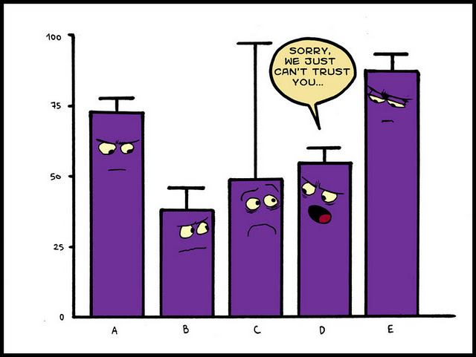
Chapter 12: Expected Values of Functions of Discrete Random Variables; Variance of Discrete Random Variables
http://fightingdarwin.blogspot.com/2011_12_01_archive.html

Slide 2
Example: Expected Value of a Function
Consider a situation where a discrete random variable can have the values from -2 to 2. (Like a person can take a seat up to 2 places to the left of center (-2) and 2 places to the right of center (+2).)
What is E(X²)?

Slide 3
Example: (2nd time)
An individual who has automobile insurance form a certain company is randomly selected. Let X be the number of moving violations for which the individual was cited during the last 3 years. The PMF of X is
If the cost of insurance depends on the following function of accidents, g(x) = 400 + (100x - 15), what is the expected value of the cost of the insurance?
What is the expected value of X²?
x | 0 | 1 | 2 | 3
p_{X}(x) | 0.60 | 0.25 | 0.10 | 0.05

Slide 4
Example: Variance
A school class of 120 students are driven in 3 buses to a basketball game. There are 36 students in one of the buses, 40 students in another, and 44 on the third bus. When the buses arrive, one of the 120 students is randomly chosen. Let X denote the number of students on the bus of that randomly chosen student. Find the variance of X.

Slide 5
Example: Properties of Variance
An individual who has automobile insurance form a certain company is randomly selected. Let X be the number of moving violations for which the individual was cited during the last 3 years. The PMF of X is
a) If the cost of insurance depends on the following function of accidents, g(x) = 400 + (100x- 15), what is the variance of the cost of insurance?
X | 0 | 1 | 2 | 3
p_{X}(x) | 0.60 | 0.25 | 0.10 | 0.05

Slide 6
Example: Properties of Variance (cont)
An individual who has automobile insurance form a certain company is randomly selected. Let X be the number of moving violations for which the individual was cited during the last 3 years. The PMF of X is
b) If the cost of insurance depends on the following function of accidents, g(x) = 400 + (100x- 15), what is the variance of the cost of insurance for 3 people who are independent?
X | 0 | 1 | 2 | 3
p_{X}(x) | 0.60 | 0.25 | 0.10 | 0.05

