Slide 1
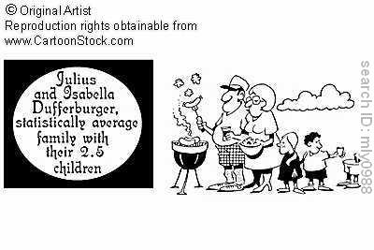
Chapters 10: Expected Values of Discrete Random Variables
http://www.cartoonstock.com/directory/a/average_family_gifts.asp

Slide 2
Example: Expectation
A school class of 120 students are driven in 3 buses to a basketball game. There are 36 students in one of the buses, 40 students in another, and 44 on the third bus. When the buses arrive, one of the 120 students is randomly chosen. Let X denote the number of students on the bus of that randomly chosen student. Find E(X).

Slide 3
Example: Expectation
An individual who has automobile insurance form a certain company is randomly selected. Let X be the number of moving violations for which the individual was cited during the last 3 years. The mass of X is
Calculate E(X).
x | 0 | 1 | 2 | 3
p_{X}(x) | 0.60 | 0.25 | 0.10 | 0.05

Slide 4
Example 10.10: Expectation
The top five cards of a shuffled deck of cards are dealt to a player. What is the expected number of hearts that the player receives?

Slide 5
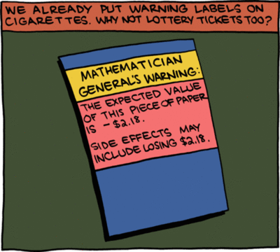
Chapter 11: Expected Values of Sums of Random Variables
http://faculty.wiu.edu/JR-Olsen/wiu/stu/m206/front.htm

Slide 6
Example: Expected values of Sums
An individual who has automobile insurance form a certain company is randomly selected. Let X be the number of moving violations for which the individual was cited during the last 3 years. The PMF of X is
If the cost of insurance depends on the following function of accidents, g(x) = 400 + (100x- 15), what is the expected value of the cost of the insurance?
X | 0 | 1 | 2 | 3
p_{X}(x) | 0.60 | 0.25 | 0.10 | 0.05

Slide 7
Example: Unbiased estimator
Consider a finite population and a variable defined on it. Let µ denote the population mean – that is, the arithmetic mean of all possible observations of the variable for the entire population. Suppose that we don’t know µ and that we want to estimate it. To do so, we take a random sample of n members from the population. Let X₁, X₂, …, X_{n} denote the values of the variable for the n members selected and set
$${\overline{X}}_{n}=\frac{1}{n}\sum_{j=1}^{n}{X_{n}}$$
as the sample mean. Show that ${\overline{X}}_{n}$ is an unbiased estimator of µ -- that is E(${\overline{X}}_{n}$) = µ.

Slide 8
Example 11.10: Indicator Random Variables
In a shuffled deck of cards, a student selects cards without replacement until the ace of spaces is drawn.
How many cards does the student expect to draw?

