Slide 1
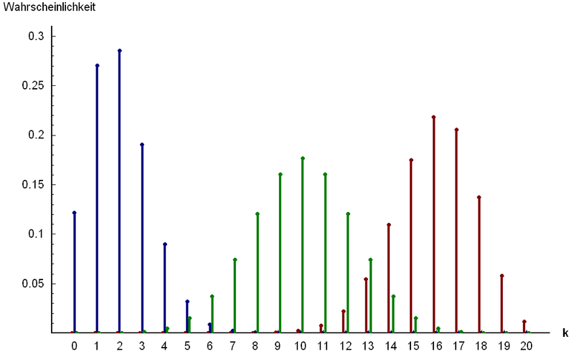
Part 3: Named Discrete Random Variables
http://www.answers.com/topic/binomial-distribution

Slide 2
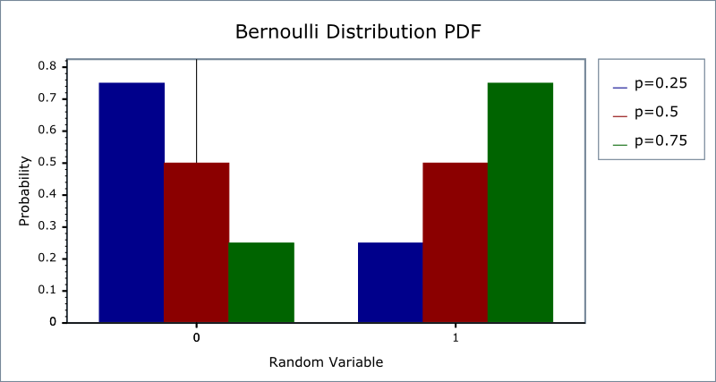
Chapter 14: Bernoulli Random Variables
http://www.boost.org/doc/libs/1_42_0/libs/math/doc/sf_and_dist/html/
math_toolkit/dist/dist_ref/dists/bernoulli_dist.html

Slide 3
Bernoulli distribution: Summary
Things to look for: one trial, success or failure
Variable: $X=\left\{\begin{matrix}0 & outcome is a failure \\ 1 & outcome is a success\end{matrix}\right.$
Parameter:
p = P(S), q = P(F) = 1 – p
Notation: X ~ Bernoulli (p)
Mass:
P(X = 1) = p, P(X = 0) = q
$𝔼$(X) = p
Var(X) = pq
x | 0 | 1
p_{X}(x) | q = 1 - p | p

Slide 4
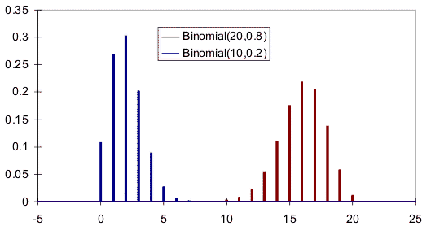
Chapter 15: Binomial Random Variables
http://www.vosesoftware.com/ModelRiskHelp/index.htm#Distributions
/Discrete_distributions/Binomial_distribution.htm

Slide 5
Binomial distribution: Summary
Things to look for: BInS
Variable: X = # of success in n trials (0 ≤ X ≤ n)
Parameters:
n: number of trials (n = 1 → Bernoulli)
p = P(S) = constant, q = P(F) = 1 – p
Mass:
$P\left(X=x\right)=\left({n \atop x}\right)p^{x}q^{n−x}, x=0, 1, ⋯, n$
$𝔼$(X) = np
Var(X) = npq

Slide 6
Shapes of Histograms
Symmetric
Right skewed
Left skewed

Slide 7
Probability histograms for binomial distributions with different p’s with n = 8
p = 0.2
p = 0.5
p = 0.8

Slide 8
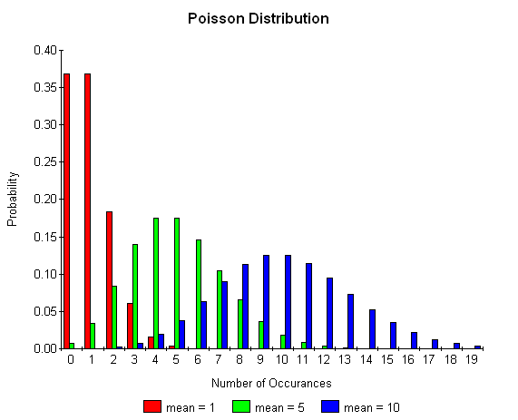
Chapter 18: Poisson Random Variables
http://www.boost.org/doc/libs/1_35_0/libs/math/doc/sf_and_dist/html
/math_toolkit/dist/dist_ref/dists/poisson_dist.html

Slide 9
Derivation of Poisson (1)
Assume, p is small, n is large and np is moderate
$$P\left(X=k\right)=\left({n \atop k}\right)p^{k}{(1−p)}^{n−k}$$
$$np=λ⟹p=\frac{λ}{n}$$
$$=\frac{n!}{\left(n−k\right)!k!}{\left(\frac{λ}{n}\right)}^{k}{\left(1−\frac{λ}{n}\right)}^{n−k}$$
$$=\frac{n(n−1)(n−2)⋯(n−k+1)}{n^{k}}\frac{λ^{k}}{k!}\frac{{\left(1−\frac{λ}{n}\right)}^{n}}{{\left(1−\frac{λ}{n}\right)}^{k}}$$

Slide 10
Derivation of Poisson (2)
If n is large and λ is moderate
$${\left(1−\frac{λ}{n}\right)}^{k}≈1$$
$${\left(1−\frac{λ}{n}\right)}^{n}≈e^{−λ}$$
$$\frac{n(n−1)(n−2)⋯(n−k+1)}{n^{k}}≈1$$

Slide 11
Derivation of Poisson (3)
$$P\left(X=k\right)$$
$$=\frac{n(n−1)(n−2)⋯(n−k+1)}{n^{k}}\frac{λ^{k}}{k!}\frac{{\left(1−\frac{λ}{n}\right)}^{n}}{{\left(1−\frac{λ}{n}\right)}^{k}}$$
$$≈\frac{e^{−λ}λ^{k}}{k!}$$

Slide 12
Poisson distribution: Summary
Things to look for: BIS*
Variable: X = # of successes during the specified ‘period’
Parameters:
λ = the average rate of events
Notation: X ~ Poisson (λ)
Mass:
$P\left(X = x\right)=\frac{e^{−λ}λ^{x}}{x!}, x =0,1, …$
$𝔼$(X) = λ
Var(X) = λ

Slide 13
Poisson Process Conditions
A counting process, {N(t)|t ≥ 0} is said to be a Poisson process with rate λ if
N(0) = 0
{N(t)|t ≥ 0} has independent increments
N(t) – N(s) ~ Poisson (λ⋅(t-s)) for 0 ≤ s < t < ∞

Slide 14
Example: Poisson Distribution
In any one hour period, the average number of phone calls per minute coming into the switchboard of a company is 2.5.
a) What is the probability that exactly 2 phone calls are received in the next hour?
b) What is the probability that there will be exactly 6 phone calls in the next 2 hours?

Slide 15
Poisson vs. Binomial
On my page of notes, I have 2150 characters. Say that
the chance of a typo (after I proof it) is 0.001.
P(X = x) | Binomial | Poisson
0 | 0.11636 | 0.11648
1 | 0.25042 | 0.25044
2 | 0.26935 | 0.26922
3 | 0.19305 | 0.19294
4 | 0.10372 | 0.10371
5 | 0.04456 | 0.04459
6 | 0.01595 | 0.01598
7 | 0.00489 | 0.00491
8 | 0.00131 | 0.00132
9 | 0.00031 | 0.00032

Slide 16
Poisson vs. Bionomial

Slide 17
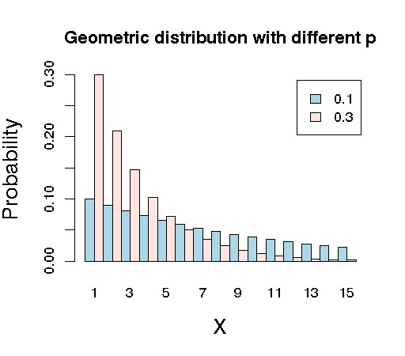
Chapter 15: Geometric Random Variables
http://raven.iab.alaska.edu/~ntakebay/teaching/programming/probability/node8.html
X

Slide 18
Geometric distribution: Summary
Things to look for: BIS
Variable: X = # of trials until the first success (1 ≤ X)
Parameters:
p = P(S) = constant, q = P(F) = 1 – p
Mass:
P(X = x) = q^{x-1}p, x = 1, 2, 3, …
$$𝔼\left(X\right)=\frac{1}{p}$$
$$Var\left(X\right)=\frac{q}{p^{2}}$$
X

Slide 19
Example: Geometric Distribution
Suppose that we roll an 20-sided die until a '1' is rolled. Let X be the number of times it takes to roll the '1'.
Why is this a geometric distribution?
What is the PMF of X?
What is the probability that it will take exactly 10 rolls?
If you decide in advance that you will roll the die 10 times, what is the probability that you will have exactly one ‘1’? How is this different from part c)?
What is the expected number of rolls?
What is the standard deviation of the number of rolls?
*What does the mass look like?
*What does the CDF look like?
X

Slide 20
Shape of Geometric PMF
X

Slide 21
Example: Geometric r.v. (cont)
Suppose that we roll an 20-sided die until a '1' is rolled. Let X be the number of times it takes to roll the '1'.
What is the probability that it will take no more than 10 rolls?
What is the probability that it will take between 10 and 20 rolls (exclusive)?
Determine the number of rolls so that the person has a 90% or greater chance of rolling a ‘1’?
X

Slide 22
Example: Geometric r.v. (cont)
Suppose that we roll an 20-sided die until a '1' is rolled. Let X be the number of times it takes to roll the '1'.
What is the probability that it will takes more than 10 rolls to roll the ‘1’?
Assuming that it takes more than 20 rolls to roll the ‘1’. Find the probability that it will take more than 30 rolls to roll the ‘1’?
X

Slide 23
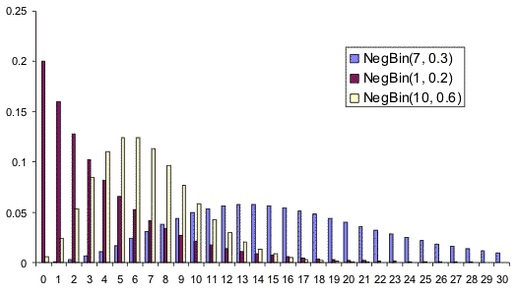
Chapter 16: Negative Binomial Random Variables
http://www.vosesoftware.com/ModelRiskHelp/index.htm#Distributions
/Discrete_distributions/Negative_Binomial.htm
X

Slide 24
Negative Binomial distribution: Summary
Things to look for: BIS
Variable: X = # of trials until the r^{th} success (r ≤ X)
Parameters:
r = the desired number of successes
p = P(S) = constant, q = P(F) = 1 – p
Mass:
$P\left(X = x\right)= \left({x−1 \atop r−1}\right)qx_rpr, x =r,r+1, …$
$$𝔼\left(X\right)=\frac{r}{p}$$
$$Var\left(X\right)=\frac{qr}{p^{2}}$$
X

Slide 25
Example: Negative Binomial r.v.
Suppose that we roll an n-sided die until a '1' is rolled. Let X be the number of times it takes to roll the ninth '1'.
Why is this a Negative Binomial situation?
What are the possible values of x?
What is the PMF of X?
What is the probability that it will take 40 rolls?
What is the expected number of rolls?
What is the standard deviation of the number of rolls?
X

Slide 26
Comparison: Binomial vs. Negative Binomial
 | Binomial | Negative Binomial
Question | What is the prob. that that you will roll 9 “1’s in the first 40 rolls? | What is the probability that 40th roll will be the 9th ‘1’?
Distribution | X ~ Binomial (n = 40, p = 0.05) | X ~ NegBinomial (r = 9, p = 0.05)
Meaning of X | X = # of successes = 9 | X = # of rolls until the 9th ‘1’
Probabiltiy | $$P\left(X=9\right)=\left({40 \atop 9}\right){0.05}^{9}{0.95}^{31}=1.09×{10}^{−4}$$ | $$P\left(X=40\right)=\left({39 \atop 8}\right){0.05}^{9}{0.95}^{31}=2.45×{10}^{−5}$$
X

Slide 27
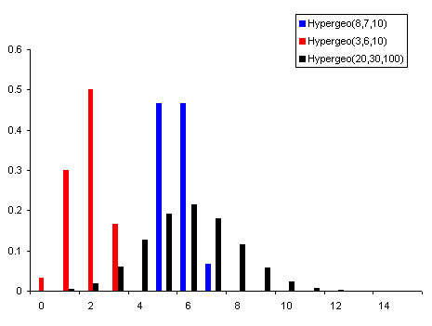
Chapter 18: Hypergeometric Random Variables
http://www.vosesoftware.com/ModelRiskHelp/index.htm#Distributions
/Discrete_distributions/Hypergeometric_distribution.htm
X

Slide 28
Hypergeometric distribution: Summary
Things to look for: Bn, without Replacement
Variable: X = # of successes
Parameters:
N = total number of items in population
M = total number of successes in population
N – M = total number of failures in population
n = items selected
Mass:
$P\left(X = x\right)=\frac{\left({M \atop x}\right)\left({N−M \atop n−x}\right)}{\left({N \atop n}\right)}$
$$𝔼\left(X\right)=n\frac{M}{N}$$
$$Var\left(X\right)=n\frac{M}{N}\left(1−\frac{M}{N}\right)\frac{N−n}{N−1}$$
X

Slide 29
Example: Hypergeometric Distribution
A quality assurance engineer of a company that manufactures TV sets inspects finished products in lots of 100. He selects 5 of the 100 TV’s at random and inspects them thoroughly. Let X denote the number of defective TV’s obtained. If, in fact 6 of the 100 TVs in the current lot are actually defective, find the mass of the random variable X.
X

Slide 30
Example: Hypergeometric Distribution (2) - class
A textbook author is preparing an answer key for the answers in a book. In 500 problems, the author has made 25 errors. A second person checks seven of these calculations randomly. Assume that the second person will definitely find the error in an incorrect answer.
Explain in words what X is in this story. What values can it take?
Why is this a Hypergeometric distribution? What are the parameters?
What is the probability that the second person finds exactly 1 error?
What is the probability that the second person finds at least 2 errors?
What is the expected number of errors that the second person will find?
What is the standard deviation of the number or errors that the second person will find?
X

Slide 31
Example: Capture-Recapture Sampling
Estimating the Size of a Population. Suppose that an unknown number, N, of bluegills inhabit a small lake and that we want to estimate that number. One procedure for doing so, often referred to as the capture-recapture method, is to proceed as follows:
Capture and tag some of the fish, say 250 and then release the fish back into the lake and give them time to disperse.
Capture some more of the animals, say 150, and determine the number that are tagged, say 16. These are the recaptures.
Use the data to estimate N.
X

Slide 32
Example: Hoosier Lotto (class)
The Lotto. In the Hoosier lotto, a player specifies six numbers of her choice from the numbers 1 – 48. In the lottery drawing, six winning numbers are chosen at random without replacement from the numbers 1 – 48. To win a prize, a lotto ticket must contain two or more of the winning numbers.
Confirm the mass of X from the Hoosier lottery web site which is on the next page. (Homework)
If the player buys one Lotto ticket, determine the probability that she wins a prize (at least 2 numbers correct).
If the player buys one Lotto ticket per week for a year, determine the probability that she wins a prize at least once in the 52 tries. (Hint: What is this distribution?)
X

Slide 33
Example: Hoosier Lotto (cont)
These are the odds from the Hoosier lottery (https://www.hoosierlottery.com/games/hoosier-lotto)
6 OF 6 1:12,271,512 5 OF 6 1:48,696
4 OF 6 1:950 3 OF 6 1:53
2 OF 6 1:7
X

Slide 34
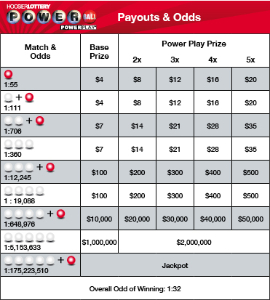
Example: Powerball (BONUS)
When playing Powerball, you receive a ticket with five (5) numbers from 1 – 59 and one (1) Powerball number from 1 – 35. Confirm the following odds (including the overall odds of winning):
X

Slide 35
Binomial Approximation to the Hypergeometric
M = 200
X

Slide 36
Chapter 19: Discrete Uniform Random Variables
http://www.milefoot.com/math/stat/pdfd-uniformdisc.htm
X

Slide 37
Discrete Uniform distribution: Summary
Things to look for: equally likelihood situation
Variable: X = the choice of the outcome
Parameters:
N = total number of possible outcomes
Mass:
$P\left(X = x\right)=\frac{1}{N}, x=1, 2, …, N$
$$𝔼\left(X\right)=\frac{N+1}{2}$$
$$Var\left(X\right)=\frac{N^{2}−1}{12}$$
X

Slide 38
Example: Discrete Uniform (class)
A charitable organization is conducting a raffle in which the grand prize is a new car. Five thousand tickets, numbered 0001, 0002, …, 5000 are sold at $10 each. At the grand-prize drawing, one ticket stub will be selected at random from the 5000 ticket stubs
a) Why is this a Discrete Uniform distribution, and what is the parameter?
b) Explain in words what X is terms of the story? What values can it take on?
c) Suppose that you hold tickets numbered 1003 – 1025. What is the probability that you win the grand prize?
Calculate the following even though they don’t really mean anything.
d) What is the expected value of the winning number?
e) What is the standard deviation?
X

Slide 39
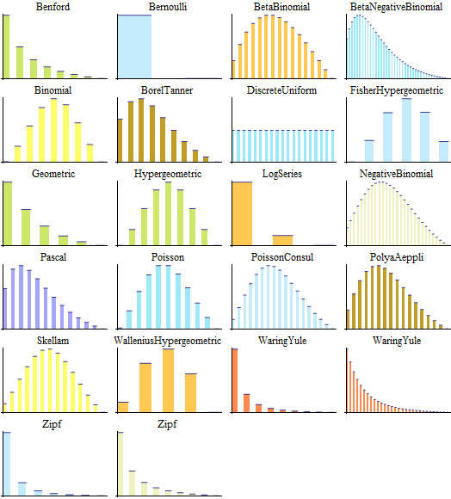
Chapter 20: Summary of Part III
http://www.wolfram.com/mathematica/new-in-8/parametric-probability-distributions
/univariate-discrete-distributions.html
X

Slide 40
Summary of Discrete Distributions
X
X

Slide 41
Expected values and Variances for selected families of discrete random variables.
Family | Param(s) | Expected Value | Variance
Bernoulli | p | p | q
Binomial | n,p | np | npq
Geometric | p | 1/p | q/p²
Neg. Binomial | r,p | r/p | qr/p²
Poisson | λ | λ | λ
Hypergeometric | N,n,p | $$n\frac{M}{N}$$ | $$n\frac{M}{N}\left(1−\frac{M}{N}\right)\frac{N−n}{N−1}$$
Uniform discrete | N | $$\frac{N+1}{2}$$ | $$\frac{N^{2}−1}{12}$$
X

Slide 42
Example: Determine the Distribution (class)
For each of the following situations, state which distribution (and approximation distribution if applicable) would be appropriate and why. Also please state all parameters. Note: A possible answer is ‘none’.
Exercises 20.1 – 20.9 (pp. 271 – 272)
Typo is 20.6 Let X be the number of broken ice cream cones….
20.a: Let X be the number of ice cream cones that you need to sample to find the 2nd waffle cone and the 3rd regular cone if they come from a large, independent population and 10% of the waffle cones are broken and 15% of the regular cones are broken.
20.b: Let X be the number of ice cream cones in your sample which are broken if you sample 50 of them from 2 boxes, one of which was roughly handled and the other was handled normally. Assume that 12% of the cones from the plant are broken and handling the box roughly breaks an additional 2%.
20.c: Let X be the number of broken ice cream cones that you give to your class of 20 if originally 12 of the 100 ice cream cones in the box are broken. To avoid jealousy, you give one ice cream cone per person whether they are broken or not.
X

