Slide 1
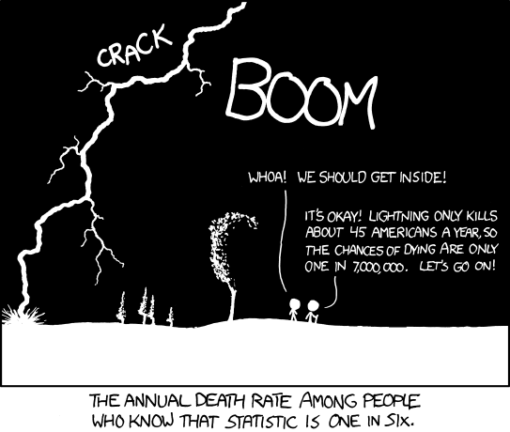
Chapter 4: Conditional Probability
http://imgs.xkcd.com/comics/conditional_risk.png

Slide 2
Example 1: Conditional Probability
Roll a fair 4 sided die 3 times
A = the event that two 1’s are tossed
B = the event that the first roll is an 1
C = the event that the second roll is an 1
Find: P(B|A), P(A|B), P(B|C)

Slide 3
Example 2: Conditional Probability
A bus arrives punctually at a bus stop every half hour. Each morning, a commuter named Sarah leaves her house and casually strolls to the bus stop.
a) Find the probability that that wait time is at least 10 minutes.
b) Find the probability that the wait time is at least 10 minutes given that if someone is waiting there for more than 15 minutes, they will get a ride from a passing car.
c) Find the probability that the wait time is at most 10 minutes given that if someone is waiting there for more than 15 minutes, they will get a ride from a passing car.

Slide 4
Example 3: Conditional Probability
1) From the set of all families with two children, a family is selected at random and is found to have a girl. What is the probability that the other child of the family is a girl?
2) From the set of all families with two children, a child is selected at random and is found to be a girl. What is the probability that the other child of the family is a girl?

Slide 5
Theorem 4.10: Distributive Laws
For any events, A₁, A₂, …

Slide 6
Example: Conditional Probabilities - Axioms
Assume that the probability that there will be more than 1 inch of snow next week given that the temperature rises above 30 ºF is 0.3.
a) What is the probability that there will be less than 1 inch of snow next week given that the temperature rises above 30 ºF?
b) Given that the probability that there will be more than 2 inches of rain given that the temperature rises above 30 ºF is 0.8 and the probability that there will be more than 2 inches of rain and there will be less than 1 inch of snow given that the temperature rises above 30 ºF is 0.6, what is the probability that there will be more than 2 inches of rain or there will be less than 1 inch of snow given that the temperature rises above 30 ºF?

