Slide 1
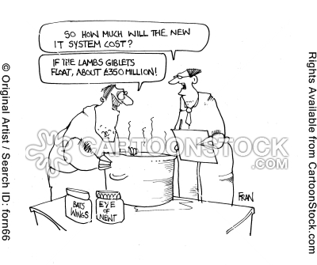
Chapter 3: Independent Events
http://www.cartoonstock.com/directory/p/probability.asp

Slide 2
Example: Independence
Roll a red 4 sided die and a white 4 sided die.
Let A: event that the red die is a 1
B: event that the white die is a 1
C: event that the sum of the two dice is 4
Are events A and B independent?
Are events A and C independent?

Slide 3
Example: Disjoint and Independent
Roll a red 4 sided die and a white 4 sided die. Are each of the following disjoint and/or independent?
1) A: event that the red die is a 1
B: event that the red die is a 2
2) A: event that the red die is a 1
B: event that the white die is a 2
3) A: event that the red die is a 1
B: event that the sum of the two dice is 4

Slide 4
Example: Pairwise Independence
Roll a red 4 sided die and a white 4 sided die.
Let A: event that the red die is even
B: event that the white die is even
C: event that the sum of the two dice is even
Show that A, B, and C are pairwise independent.
Show that A ∩ B and C are NOT independent.

Slide 5
Example: Mutual Independence
Roll a red 6 sided die and a white 6 sided die.
Let D: event that the red die is 1 or 2 or 3
E: event that the white die 4 or 5 or 6
F: event that the sum of the two dice is 5
Show that P(D ∩ E ∩ F) = P(D)P(E)P(F) but D, E and F are NOT (mutually) independent events.

Slide 6
Example 3.19: Independence
A student flips a coin until the tenth head appears. Let A denote the event that at least 3 flips are needed between the 7th and 8th heads; let B denote the event that at least 3 flips are needed between the 8th and 9th heads.
What would be considered the trial?
Are A and B independent?

Slide 7
Example: Independence (cont.)
If the probability that a fuse is good in a particular batch of fuses is 0.8 and each fuse is independent of the other fuses, what is the probability that 2 fuses are bad?

Slide 8
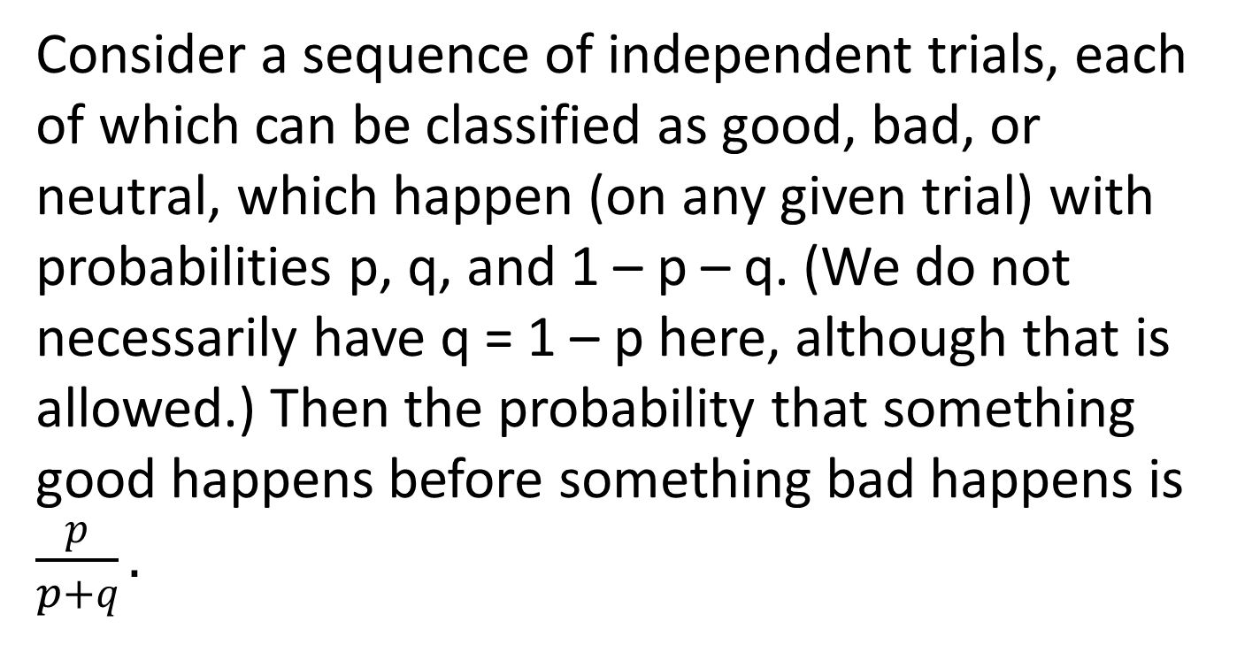
Theorem 3.24: Good before Bad
Consider a sequence of independent trials, each of which can be classified as good, bad, or neutral, which happen (on any given trial) with probabilities p, q, and 1 – p – q. (We do not necessarily have q = 1 – p here, although that is allowed.) Then the probability that something good happens before something bad happens is $\frac{p}{p+q}.$

