Slide 1
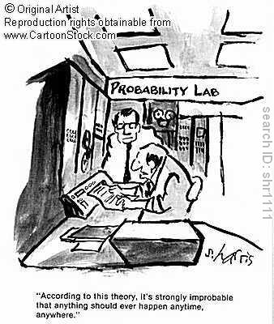
Chapter 2: Probability
http://www.cartoonstock.com/directory/p/probability.asp

Slide 2
How To Do Story Problems?
Write down all of the information
Determine what methodology to use
Solve the problem.

Slide 3
How To Do Proofs?
Write down what you want to prove in symbols
For each step, write down a reason
Examples
Theorem 2.5: The probability of the empty set is always 0.
Theorem 2.6: If A₁, A₂, …, A_{n} is a collection of finitely many disjoint events, then the probability of the union of the events equals the sum of the probabilities of the events.

Slide 4
What is Probability?
Frequentist point of view
  The probability of an event is the long-run proportion of times that the event occurs in independent repetitions of the random experiment.
Bayesian
  Conditional probability

Slide 5
Frequentist Interpretation

Slide 6
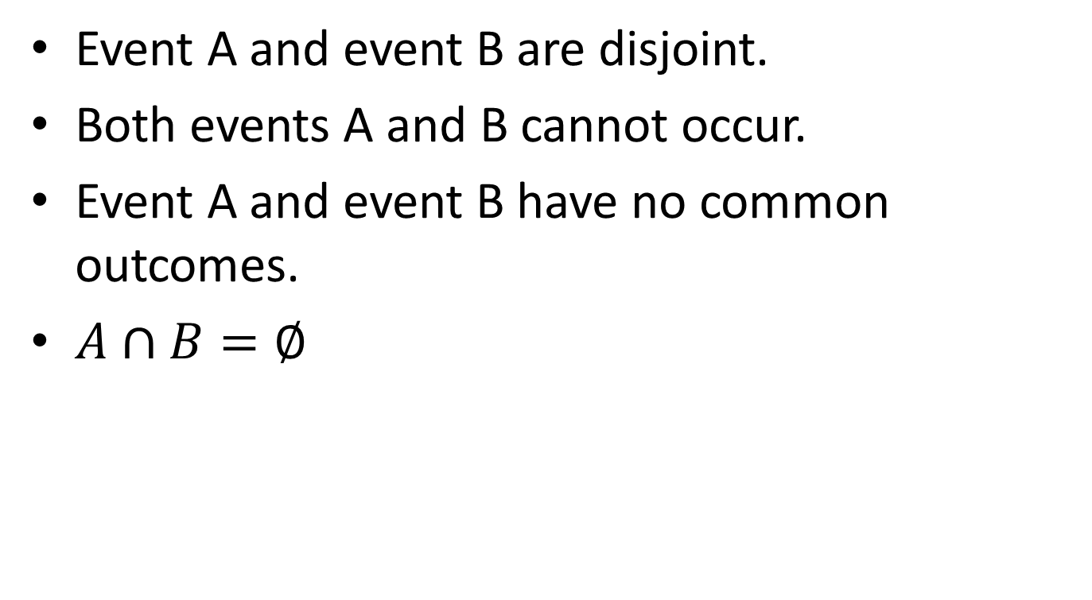
Disjoint
Event A and event B are disjoint.
Both events A and B cannot occur.
Event A and event B have no common outcomes.
$A∩B=∅$

Slide 7
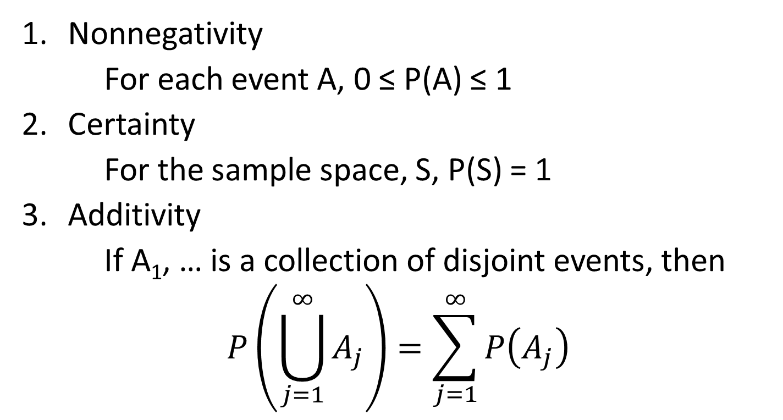
Axioms 2.4
Nonnegativity
For each event A, 0 ≤ P(A) ≤ 1
Certainty
For the sample space, S, P(S) = 1
Additivity
If A₁, … is a collection of disjoint events, then
$$P\left(\bigcup_{j=1}^{∞}{A_{j}}\right)=\sum_{j=1}^{∞}{P\left(A_{j}\right)}$$

Slide 8
Example: Legitimate Probabilities of Sample Spaces
Row # | Outcome | #1 | #2 | #3 | #4 | #5 | #6
1 | 11 | 0.0625 | 0 | 0.1 | 0.1 | 0.05 | 0.05
2 | 12 | 0.0625 | 0 | 0.1 | 0.1 | 0.05 | 0.05
3 | 13 | 0.0625 | 0 | 0.1 | 0.1 | 0.05 | 0.05
4 | 14 | 0.0625 | 0 | 0.1 | 0.1 | 0.05 | 0.05
5 | 21 | 0.0625 | 0.25 | 0.1 | 0.2 | 0.1 | 0.1
6 | 22 | 0.0625 | 0.25 | 0.1 | 0.2 | 0.1 | 0.1
7 | 23 | 0.0625 | 0.25 | 0.1 | 0.2 | 0.1 | 0.1
8 | 24 | 0.0625 | 0.25 | 0.1 | 0.2 | 0.1 | 0.1
9 | 31 | 0.0625 | 0 | 0.1 | -0.1 | 0 | 0.01
10 | 32 | 0.0625 | 0 | 0.1 | -0.1 | 0 | 0.01
11 | 33 | 0.0625 | 0 | 0.1 | -0.1 | 0 | 0.01
12 | 34 | 0.0625 | 0 | 0.1 | -0.1 | 0 | 0.01
13 | 41 | 0.0625 | 0 | 0.1 | 0.05 | 0.1 | 0.05
14 | 42 | 0.0625 | 0 | 0.1 | 0.05 | 0.1 | 0.05
15 | 43 | 0.0625 | 0 | 0.1 | 0.05 | 0.1 | 0.05
16 | 44 | 0.0625 | 0 | 0.1 | 0.05 | 0.1 | 0.05

Slide 9
Types of Probabilities
Equally Likely Events
Empirical
Subjective

Slide 10
Section 2.3: Theorems
Complementation Rule:
Th. 2.19: P(A^{c}) = 1 – P(A)
Domination Principle:
Th. 2.20: If A ⊂ B, the P(A) ≤ P(B).

Slide 11
Section 2.4 Inclusion/Exclusion
(General Addition Rule)
Th. 2.22: For any two events A and B,
P(A U B) = P(A) + P(B) – P(A ∩ B)

Slide 12
Example 2.26
Consider a student who draws cards from a deck. After he draws the card, he replaces the card and then reshuffles the deck. He stops if he draws the ace of spaces.
What is the probability of B_{k}, when the ace of spaces is found for the first time on the k^{th} draw?

Slide 13
Example 2.27
A student hears ten songs (in a random shuffle mode) on her music player, paying special attention to how many of these songs belong to her favorite type of music. We assume the songs are picked independently of each other and that each song has probability p of being a song of the student’s favorite type.
What is P(A_{j}) where A_{j} is the event that exactly j of the 10 songs are from her favorite type of music?

