Slide 1
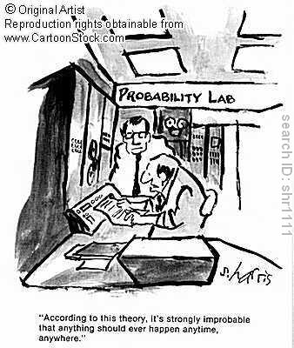
Chapter 2: Probability
http://www.cartoonstock.com/directory/p/probability.asp

Slide 2
Frequentist Interpretation

Slide 3
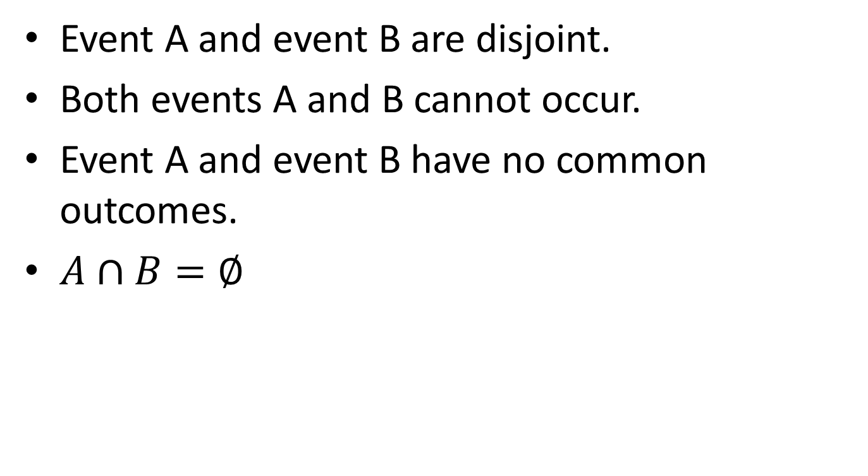
Disjoint
Event A and event B are disjoint.
Both events A and B cannot occur.
Event A and event B have no common outcomes.
$A∩B=∅$

Slide 4
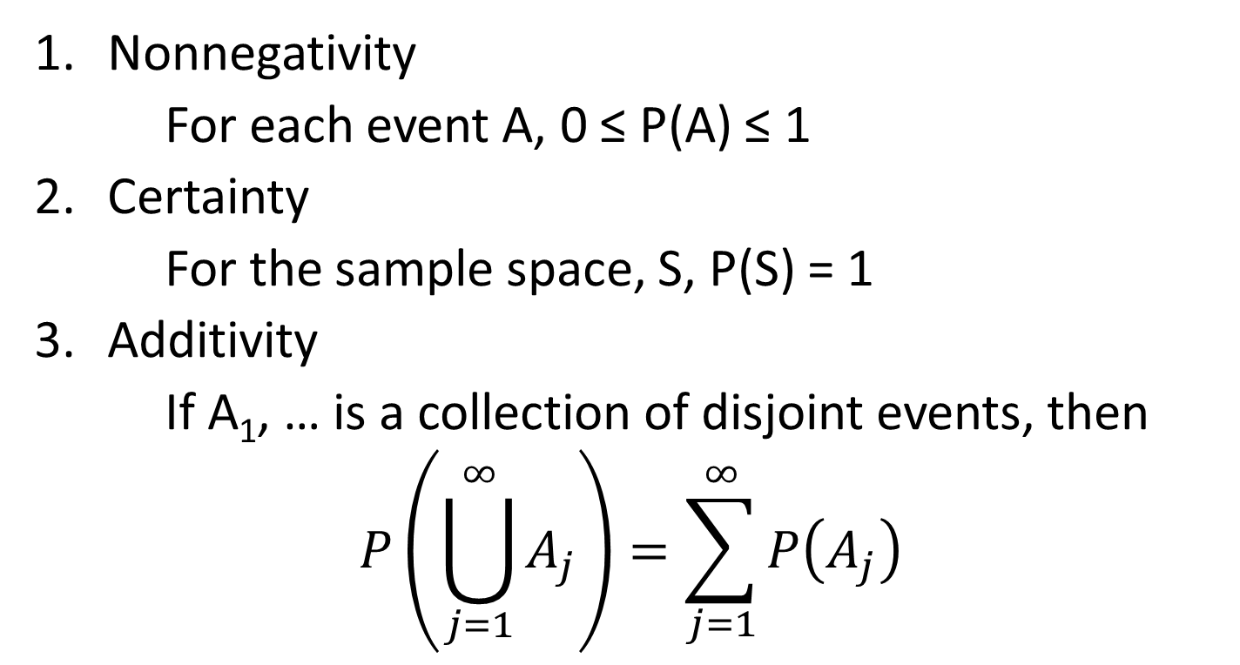
Axioms 2.4
Nonnegativity
For each event A, 0 ≤ P(A) ≤ 1
Certainty
For the sample space, S, P(S) = 1
Additivity
If A₁, … is a collection of disjoint events, then
$$P\left(\bigcup_{j=1}^{∞}{A_{j}}\right)=\sum_{j=1}^{∞}{P\left(A_{j}\right)}$$

Slide 5
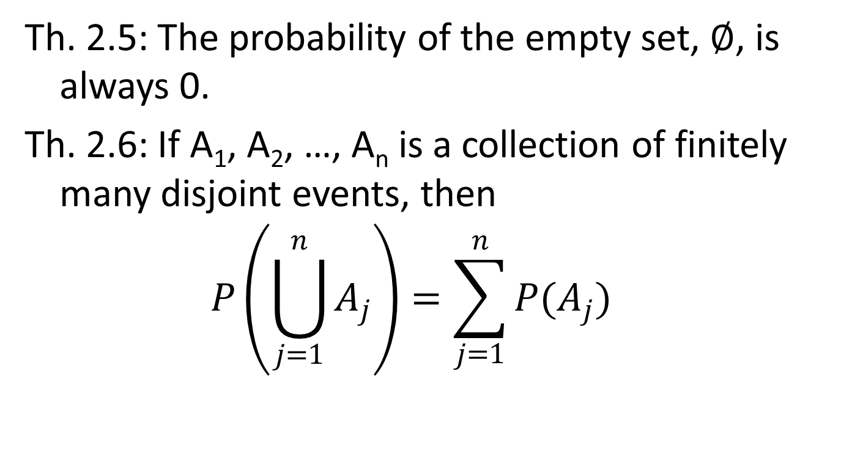
Theorems
Th. 2.5: The probability of the empty set, $∅$, is always 0.
Th. 2.6: If A₁, A₂, …, A_{n} is a collection of finitely many disjoint events, then
$$P\left(\bigcup_{j=1}^{n}{A_{j}}\right)=\sum_{j=1}^{n}{P(A_{j})}$$

Slide 6
Example: Legitimate Probabilities of Sample Spaces
Row # | Outcome | #1 | #2 | #3 | #4 | #5 | #6
1 | 11 | 0.0625 | 0 | 0.1 | 0.1 | 0.05 | 0.05
2 | 12 | 0.0625 | 0 | 0.1 | 0.1 | 0.05 | 0.05
3 | 13 | 0.0625 | 0 | 0.1 | 0.1 | 0.05 | 0.05
4 | 14 | 0.0625 | 0 | 0.1 | 0.1 | 0.05 | 0.05
5 | 21 | 0.0625 | 0.25 | 0.1 | 0.2 | 0.1 | 0.1
6 | 22 | 0.0625 | 0.25 | 0.1 | 0.2 | 0.1 | 0.1
7 | 23 | 0.0625 | 0.25 | 0.1 | 0.2 | 0.1 | 0.1
8 | 24 | 0.0625 | 0.25 | 0.1 | 0.2 | 0.1 | 0.1
9 | 31 | 0.0625 | 0 | 0.1 | -0.1 | 0 | 0.01
10 | 32 | 0.0625 | 0 | 0.1 | -0.1 | 0 | 0.01
11 | 33 | 0.0625 | 0 | 0.1 | -0.1 | 0 | 0.01
12 | 34 | 0.0625 | 0 | 0.1 | -0.1 | 0 | 0.01
13 | 41 | 0.0625 | 0 | 0.1 | 0.05 | 0.1 | 0.05
14 | 42 | 0.0625 | 0 | 0.1 | 0.05 | 0.1 | 0.05
15 | 43 | 0.0625 | 0 | 0.1 | 0.05 | 0.1 | 0.05
16 | 44 | 0.0625 | 0 | 0.1 | 0.05 | 0.1 | 0.05

Slide 7
Section 2.3: Theorems
Complementation Rule:
Th. 2.19: P(A^{c}) = 1 – P(A)
Domination Principle:
Th. 2.20: If A ⊂ B, the P(A) ≤ P(B).

Slide 8
Section 2.4 Inclusion/Exclusion
(General Addition Rule)
Th. 2.22: For any two events A and B,
P(A U B) = P(A) + P(B) – P(A ∩ B)

Slide 9
Example 2.26
Consider a student who draws cards from a deck. After he draws the card, he replaces the card and then reshuffles the deck. He stops if he draws the ace of spaces.
What is the probability of B_{k}, when the ace of spaces is found for the first time on the k^{th} draw?

Slide 10
Example 2.27
A student hears ten songs (in a random shuffle mode) on her music player, paying special attention to how many of these songs belong to her favorite type of music. We assume the songs are picked independently of each other and that each song has probability p of being a song of the student’s favorite type.
What is P(A_{j}) where A_{j} is the event that exactly j of the 10 songs are from her favorite type of music?

