Slide 1
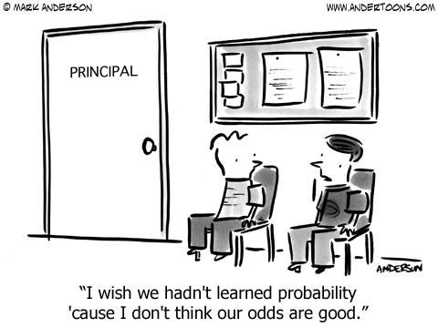
STAT 311: Introductory Probability
https://www.andertoons.com/cartoon-blog/2013/08/20-education-cartoons-for-back-to-school.html

Slide 2
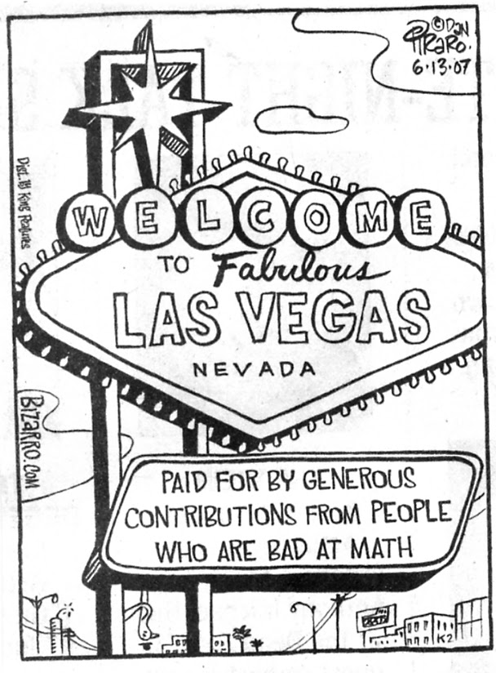
Part 1: Randomness
http://mikeess-trip.blogspot.com/2011/06/gambling.html

Slide 3
Applications of Probability

Slide 4
Applications of Probability
Games of Chance
Diagnosis of Diseases
Engineering
Biology/agriculture
Physics/Chemistry
Business Management
Computer Science

Slide 5
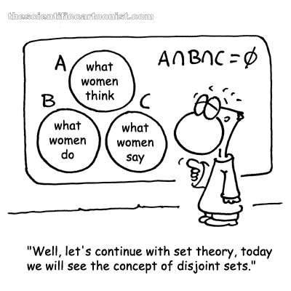
Chapter 1: Outcomes, Events, and Sample Spaces
men
men
men
http://www.thescientificcartoonist.com/?p=102

Slide 6
Replacement
Without Replacement
Draw a card and do not put it back in the deck
With Replacement
Draw a card and put it back in the deck

Slide 7
Sample Spaces: Examples
For each of the following examples, determine the sample set and state the possible values for the elements of the sample set.
Tossing Coins: We toss a coin 3 times
Rolling two 4-sided dies
Lifetime of a light bulb
Genetics: Dominant (A=black hair) or recessive (a = red hair)

Slide 8
Events: Examples
Tossing Coins: 3 times
Determine the event that there is only one Head.
Identify in words the event: {HHH,TTT}
Rolling two 4-sided dies
Determine the event that the sum of the two dice is 9.
Determine the event that the difference between the numbers of the white and red dies is 1.
Identify in words the event: {(x, x+1): x ∈ {1,2,3} }
Lifetime of a light bulb
Determine the event that the light bulb lasts between 100 and 110 hours.
Identify in words the event: {x | x < 200}
Genetics: Dominant (A=black hair) or recessive (a = red hair)
Determine the event that the hair color is black.
Identify in words the event: {aa, aA, Aa}

Slide 9
Example 1.17: Pick ten songs
A student hears 10 songs (in a random shuffle mode) on her music player, noting how many of these songs belong to her favorite type of music.
What is the sample space?
How many different events are there?
What is the event, A, that none of the first three songs are her favorite type of music? How many outcomes are there?
What is the event, B, that the even-numbered songs are from her favorite type of music? How many outcomes are there?
What is the event of A ∩ B? How many outcomes are there?
What is the event, C, that the last 5 songs are from her favorite type of music? How many outcomes are there?
What is the event B ∩ C? How many outcomes are there?

Slide 10
DeMorgan’s Laws
Theorem 1.22 DeMorgan’s first law
For a finite or infinite collection of events, A₁, A₂, …
Theorem 1.23 DeMorgan’s second law
For a finite or infinite collection of events, A₁, A₂, …

Slide 11
Set Theory: Other Laws
Distributive Laws
Let A, B, and C be subsets of S. Then
a) A ∩ (B U C) = (A ∩ B) U (A ∩ C)
b) A U (B ∩ C) = (A U B) ∩ (A U C)
Associative and Commutative Laws
Let A, B, and C be subsets of S, Then
a) A ∩ B = B ∩ A
b) A U B = B U A
c) A ∩ (B ∩ C) = (A ∩ B) ∩ C
d) A U (B U C) = (A U B) U C

Slide 12
Example: Subsets, etc.
Write down the set of events for each of the following:
Rolling 2 4-sided dice:
A: the red die is a 4 B: the white die is a 2
C: The sum of the two dice is 4
D: the red die is a 3
A^{C} f) A^{c}\C
A ∩ C g) D U (B ∩ C)
A U C h) (D U B) ∩ (D U C)
A^{C} ∩ C
A^{C} U C

