Slide 1
X-bar and R charts
Example 3.1 from older text

Slide 2
Data on part thickness
Thickness of parts recorded as amount by which
thickness exceeded 0.300 in. (everyone else has gone metric but……..)

Slide 3
Data structure
Sample Value
1 1
1 4
1 6
1 4
2 3
2 7
2 5
2 5
3 4
3 5
3 5
3 7, etc.

Slide 4
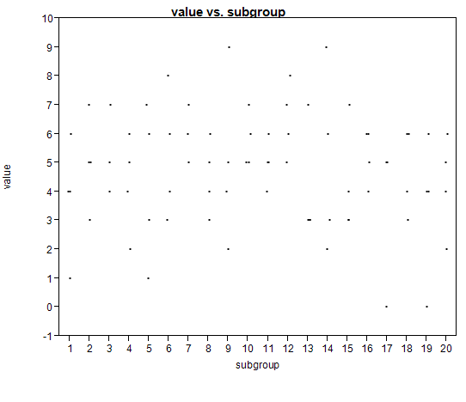
Raw data plot, thickness vs sample number

Slide 5
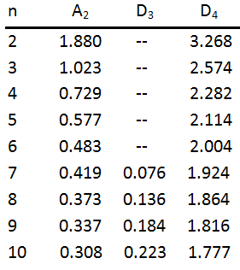
Table 3.2 constants for X-bar and R charts

Slide 6
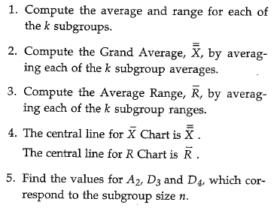
Rules for creating charts

Slide 7
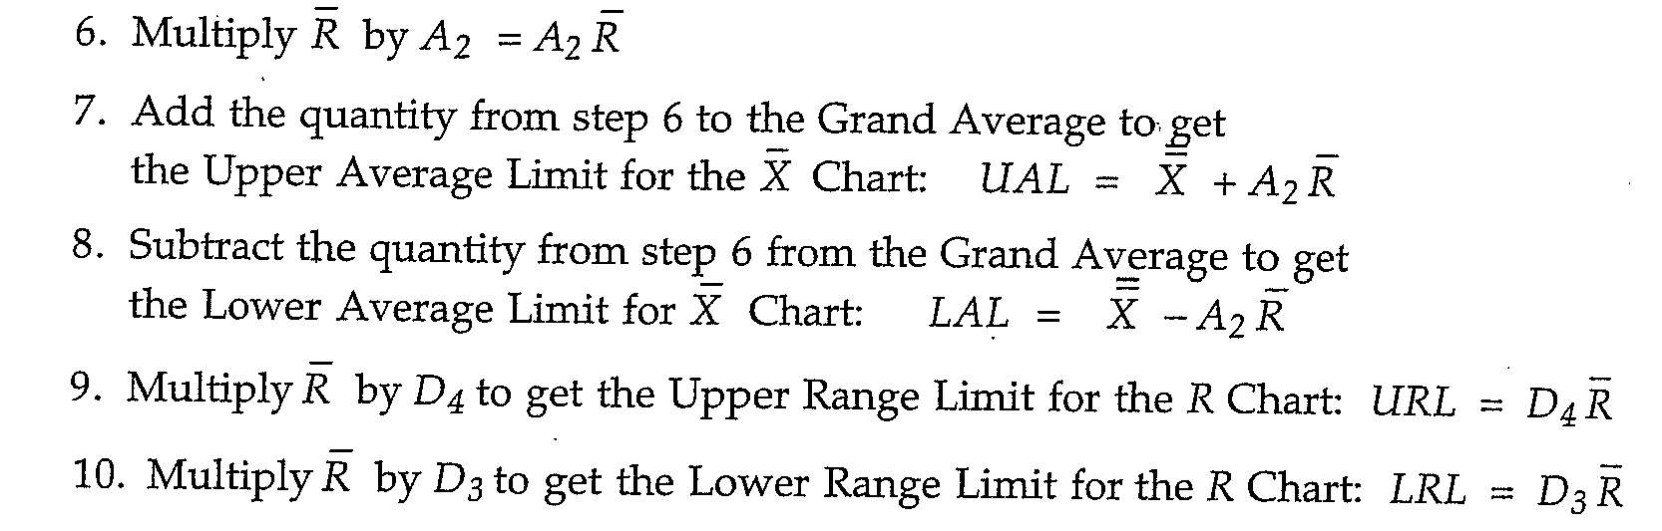
Rules, etc.

Slide 8
Limits are designed to ….
Make sure that the operator does not react to Common cause.
Indicate when you are reasonably sure that Special Cause is present.
If only Common Cause is present in the process, then the chance of a false signal is about 1%, i.e. the probability that the chart will falsely indicate the presence of Special Cause is about 0.01.

Slide 9
Similar to Hypothesis Testing
In hypothesis testing we say there is a treatment difference if p<alpha=0.05 (usually).
The chance of falsely declaring a treatment difference exists is then about 1 out of 20.
In Quality Control, we use the “1 out of 100” criteria to say that our process has more variation than just Common Cause (idea due to Shewhart, it is simple but effective in practice).

Slide 10
R-chart and Common Cause
If the data in each subgroup was collected under “homogeneous conditions”, then the Ranges should reflect only Common Cause. The chart should not indicate the presence of Special Cause.
If no signal of Special Cause is indicated, this is not proof that within subgroup variation is only due to Common Cause. (More on this later in Rational Subgrouping.)

Slide 11
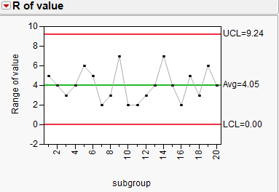
R chart

Slide 12
X-bar chart and Special Cause
If the R-chart is in control, i.e., stable and predictable, then any shifts in the mean of the process come from Special Cause. If the X-bar chart indicates the process is “out of control”, i.e., that Special Cause is present. We then use a fishbone diagram (or detailed Cause and Effect Matrix) to try to identify and remove the source of Special Cause.

Slide 13
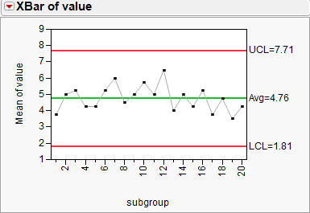
X-bar chart

