Slide 1
Six Sigma
Chad Laux

Slide 2
Strategic Model
Strategy
Goals
Processes
Projects
ISO-based QMS –
Set Standards
6 Sigma
Strategic Areas for Improvement –
Lean Thinking
Quick Wins –
Kaizen

Slide 3

Data and Facts
Practical Problem
Statistical Problem
Statistical Solution
Practical Solution

Slide 4
”Eight-five percent of the reasons for failure to meet customer expectations are related to deficiencies in systems and process…rather than the employee. The role of management is To Change The Process rather than badgering individuals to do better”
        W. Edwards Deming

Slide 5
Summary
“This is not about sloganeering or bureaucracy or filling out forms. It finally gives us a route to get to the control function, the hardest thing to do in a corporation.”
-Jack Welch
Former CEO of General Electric

Slide 6
“Learning is not compulsory... neither is survival.“
-W. Edwards Deming
Questions?

Slide 7
Outline
What is Six Sigma
The Six Sigma Organization
Leadership and Six Sigma

Slide 8
What is new about 6 Sigma?
Reliance on tried and true methods with decades use:
  SPC
  Project management
  DOE
  __________
Is Six Sigma more or less complex than other quality systems? (i.e. TQM, etc.)
Has little to do with traditional quality:
  Quality: conformance to internal requirements

Slide 9
TQM vs. Six Sigma
TQM Defined
A management approach to doing business that attempts to maximize an organization’s competitiveness through continual improvement of the quality of it’s products, services, people, processes, and environments
Six Sigma Defined
A methodology that provides businesses with the tools to improve the capability to their business processes.
Compare

Slide 10
What differentiates Six Sigma from TQM?
Strategy
  The hard tie to business strategy and business results
  The required commitment of top leadership up front and continuously through years of implementation
  Each project delivers bottom line results in a relatively short time

Slide 11
What is 6 Sigma?
Defining 6 Sigma
A vehicle for strategic change ... an organizational approach to performance excellence.
TRANSFORMATIONAL CHANGE
Across-the-board. Large-scale integration of fundamental changes throughout the organization --- processes, culture, and customers --- to achieve and sustain breakaway results.
TRANSACTIONAL CHANGE
Business processes. Tools and methodologies targeted at reducing variation and defects, and dramatically improving business results.

Slide 12
6 Sigma characteristics:
Relentless quest for perfection
Data-driven, fact-based decision making
Focusing our best people on our highest priorities
Improve the processes
Rigorous alignment of actions with strategy
Measuring bottom-line impact
Transforming how people work

Slide 13
Mikel Harry’s 6 Sigma Observations
“Selecting a tool is much like picking a spouse – both make several assumptions.”
“Black Belts are about ideas, quality engineers are about tools.”
“There are key analytical ideas that every Black Belt should ponder and explore.”
“If tools were the ticket, statisticians would be CEO’s.”
“A simple idea can often negate the need for a tool.”
“The majority of a physician’s curriculum is about knowledge, not scalpels.”
“Six sigma is about the quality of business, not the business of quality”

Slide 14

What is sigma?
Defining 6 Sigma
Sigma is the Greek letter that is a statistical unit of measurement used to define the standard deviation of a population. It measures the variability or spread of the data.
6 Sigma is also a measure of variability. It is a name given to indicate how much of the data falls within the customers’ requirements. The higher the process sigma, the more of the process outputs, products and services, meet customers’ requirements – or, the fewer the defects.

Slide 15
Sigma vs. Cost of Poor Quality
30%
2σ
COPQ as a Percent of SALES
25%
3σ
20%
4σ
15%
5σ
10%
5%
6σ
69%
93.3%
99.4%
99.98%
99.9997%
RTY (% DEFECT-FREE)
*Derived from AlliedSignal internal study and experience

Slide 16
93% v 99.9% levels
Examples of a world at 3 Sigma
  54,000 wrong drug prescriptions per year
  40,500 new-born babies per year dropped at delivery
  Usage drinking water 2 hours a month
  5 crash landings per day at the busiest airports
  54,000 lost pieces of mail per hour
Examples of a world at 6 Sigma
  1 wrong prescription in 25 years
  3 new-born babies dropped in 100 year
  Unsafe drinking water 1 second every 16 years
  1 crash landing in 10 years
  35 lost pieces of mail per year

Slide 17
Potential Value
With performance at 2 sigma:
69.146% of products and/or services meet customer requirements with
308,538 defects per million opportunities.
With performance at 4 sigma:
99.379% of products and/or services meet customer requirements ...
but there are still 6,210 defects per million opportunities.
With performance at 6 sigma:
99.99966% – As close to flaw-free as a business can get, with just 3.4 failures per million opportunities (e.g., products, services or transactions).
Waste = potential quality – actual quality

Slide 18
Three Levels of Benefits
Allows for differentiation by:
  Nature of underlying benefit
  Confidence level in benefits achieved
Provides latitude to drive behavior with quantifiable risk
All Benefit Levels Are Important

Slide 19
Level I Benefits
Nature…
Examples…
Direct impact
90% confidence required
Economic substance required
Material cost reduction
Warranty reductions
Cancel external lease
Enterprise headcount reduction
Incremental volume; price realization
Freight /scrap reduction
Finance benefit on working capital improvements
Highest Confidence, Most Visible

Slide 20
Level II Benefits
Nature…
Examples…
Productive redeployment of existing resources
  Equipment, buildings, etc.
  Whole persons
Person productively redeployed in support of enterprise growth
Equipment productively redeployed to a different plant/process thereby avoiding capital spend or outsourcing of operation
Level II Redeployments Support Efficient Growth

Slide 21
Level III Benefits
Nature…
Examples…
Avoidances
Benefits otherwise Level I except for confidence achieved:
  Level I requires 90%
  Level III requires 70%
Benefits measured on an NPV basis
Partial people efficiencies
Whole people made available for redeployment
Cost or capital avoidance
Projects with significant upfront investments
Incremental volume with 70% confidence
Efficiency gains resulting in manpower made available for redeployment
Salaried/mgmt. efficiencies – partial person
Level III Critical to Growth and Quality

Slide 22
Why Measure the Financial Impact?
Drives bottom line focus
Forces value-added mindset of projects
Ensures financial benefits from improvements are real
Facilitates filtering and prioritization of projects
What gets measured…gets done!

Slide 23
Fiscal Benefits - Summary
Six Sigma must “pay it’s way” with quantifiable measures that trace savings to the bottom line.
  Level 1 – Direct Fiscal Benefits
  Level 2 – Re-deployment of personnel
  Level 3 – Opportunities for Future Benefits
Six Sigma must be fiscally self sustaining

Slide 24
Potential* Value Extraction
Cost of Poor Quality
Cost of Poor Quality is reduced via assignment of Black Belt Project Teams to Improvement Projects:
  Seasoned Black Belts complete three to four projects annually
  $175,000 - $200,000 average savings per project
  Annual savings delivered per Black Belt $575,000 - $800,000
  Guidelines for number of Black Belts: 1% - 3% of employees

Slide 25
Six Sigma Philosophy
  Application of Scientific Method to design and operation of management systems and business processes to enable delivery of greatest value to customers and stakeholders
    Aligning core business processes with Customer and Business Requirements
    Systematically eliminating defects from existing processes, products, services, or plants
    Designing new processes, products, services, or plants that reliably and consistently meet Customer and Business Requirements
    Implementing the infrastructure and leadership systems to sustain gains and foster continuous improvement

Slide 26
6 Sigma Focuses on the Reduction of Variation that Generates Defects for Customers
Market
Suppliers
Inputs
Business Processes
Process Outputs
Critical Customer Requirements
Defects
Variation in the Process Output causes Defects that are seen by the customer
Output Variation is caused by Variation in Process Inputs and by Variation in the Process itself
Notes:
A robust analysis of business inputs, process, and outputs measured against the qualified requirements of your customers and marketplace. We look at the market and identify critical customer requirements, or CCRs, which define the parameters the customer is willing to accept.
- A critical customer requirement could come from the market/customer requirements or from business partner
-Defects are any outcomes outside of the CCR parameters
Process performance targets tied directly to customer requirements
(I.e. error-free invoicing, on-time delivery, etc.).
-6 Sigma measures how good your business model is as compared to customer/market requirements.
Reduce variations and move product or services performance within customer requirements.
-Variation in the output of processes can cause a defect.
-Root cause analysis of defects leads to permanent defect reduction.
When a defect is identified, an improvement initiative can be undertaken.
-Improvement initiatives focus on both the internal and external aspects of the businesses environment.

Slide 27
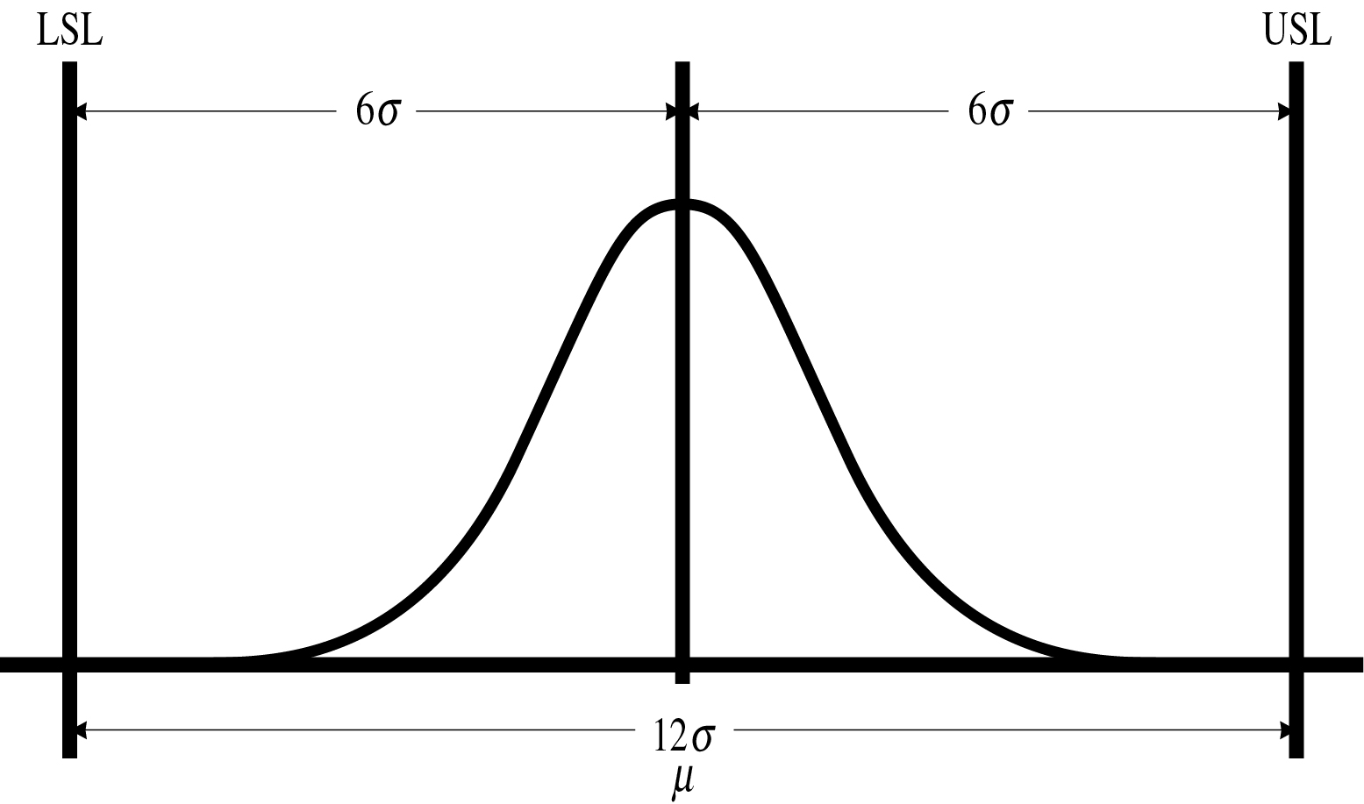
Fig. 3-8

Slide 28
Reducing the Process Output Variation
Mean
Critical Customer Requirement
Variation
Defects: Service unacceptable to customer
Product or Service Output
Notes:
Reducing variation means reducing the spread (standard deviation) of the data. Standard deviation is a measure of the concentration of the data around the center.
Example
Reducing the time to process an invoice from an average of 30 days, a maximum of 50 day and a minimum of 10 days where the rest of the processing times are distributed randomly between these; to an average of 30 days, a max of 40 days and a minimum of 20 days.

Slide 29
Moving the Mean
Mean
Mean
Critical Customer Requirement
Defects: Service unacceptable to customer
Product or Service Output
Notes:
Mean - the process performance in terms of average performance
Examples
Moving the mean time between failure from 100 days to 50 days.
Reducing the time to process an order from an average of 15 days to 5 days.
Increasing our customer referral rate from an average of 20 per month to 50 per month.

Slide 30
The Funneling Effect
Process Maps
59 Inputs
All X’s
MEASURE
C&E Matrix
17
1st “Hit List”
Failure Modes and Effects Analysis/FTA
Multi-Vari Studies
ANALYZE
8
Screened List
IMPROVE
Design of Experiments (DOE)
3
Found Critical X’s
CONTROL
Control Plans
2
Controlling Critical X’s
Critical Input Variables
Notes:
1) Show the funneling effect – by changing the number to reflect the project inputs per step.

Slide 31

Application
Plan
Do
Study
Act
Plan
Study
Study
Study

Slide 32
6 Sigma Definitions

Slide 33
Implementing Six Sigma

Slide 34
General 6 Sigma Critical Success Factors
Establishing these factors provides the seeds of success.
They need to be integrated consistently to fit each business.
They are all necessary for the best result.
The most powerful success factor is “committed leadership.”
Business Process Framework
Quantifiable
Measures & Results
Committed
Leadership
Customer & Market Network
Incentives &
Accountability
Strategy
Integration
Full Time 6 Sigma
Team Leaders

Slide 35
Strategy Defined
The fundamental decisions and actions that guide an organization is, what it does, why it does it, with a focus on the future
  Strategic Planning is a disciplined effort to accomplish all these things
  Corporation: a collection of individuals that together, produce something that has less transaction cost than individually

Slide 37
Implementing Six Sigma: 3 Basic On-Ramps
  Business Transformation
    Pros: rapid change, significant improvements in a few months
    Cons: chaotic, challenging to muster the time and people needed to meet the demands
  Strategic Improvement
    Pros: helps to focus on higher-priority opportunities, limits the challenges
    Cons: people feel left out in the process, uncertainty on how to align parts of the company that are doing Six Sigma with those that aren’t
  - Problem Solving
    Pros: less disruptive, gives the company a chance to get a feel for how it works
    Cons: doesn’t fix underlying problems or take a broad view of making change successful

Slide 38

Leadership
Champion the process by understanding 6 Sigma and committed to success
Guidance through creating “vision” by drawing mental images of future
Visions embody abstract values; convert the abstractions

Slide 39
Visioning
Stories are another way to communicate abstract ideas
Event(s) occur that capture the essence of leader’s vision
May create situation with powerful symbolic meaning and use to communicate vision – serves purpose for clarity

