Slide 1
Problem 5.2
Rational and irrational subgrouping

Slide 2
Sources of variation
Different Parts
Location within Part (Left, Right or Middle)
Position ( 1 through 8)

Slide 3
Within and Between term
The within subgroup term(s) determine what we think our estimate of Common Cause is. In general, we should try to choose our subgroups so that the within subgroup variation term(s) have the smallest variation. This make our charts the most informative.

Slide 4
Subgroup plan 1
Subgroup by Part.
Eight values per subgroup.
Each position represented within each subgroup.
Position is our within subgroup source of variation and will determine our estimate of Common Cause.

Slide 5
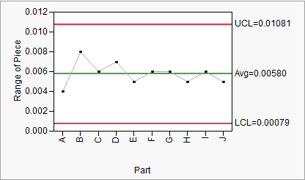
R chart

Slide 6
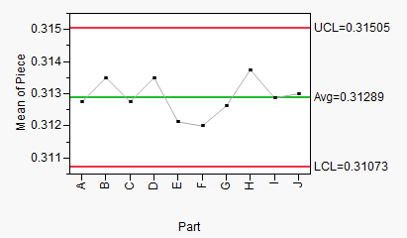
X-bar chart

Slide 7
White space
Where did the white space come from?
So we should…….?

Slide 8
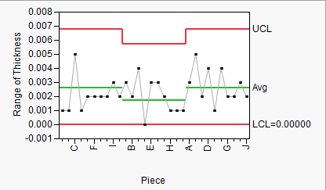
Strategy 2: Now use Location (L,M,R) as subgroups for each Part

Slide 9
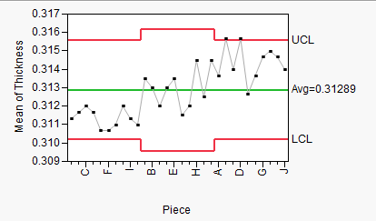
Now X-bar for Locations

Slide 10
Strategy 3
Maybe Position has the most variability.
Make Position the Between subgroup term.
Make Part the Within subgroup term.
The variability of each Position within the Parts will now give us our estimate of Common Cause.

Slide 11
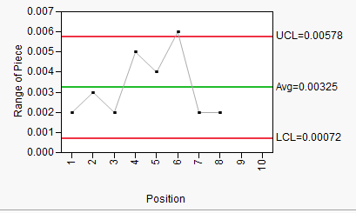
R chart first

Slide 12
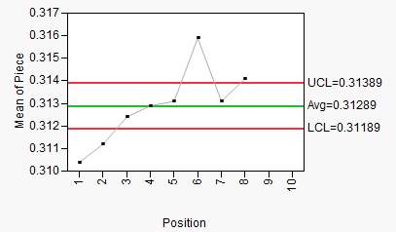
Now X-bar chart

Slide 13
What was the most informative subgrouping strategy?
Why?

