Slide 1
One-Way ANOVA
Problem 3.21
(3.23 in 8th edition)

Slide 2
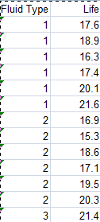
Life of Insulating Fluids, partial data

Slide 3
Model:
Life (the Response Variable) is a linear model of Fluid Type, i.e.
where the mean Life response of Fluid Type i is

Slide 4
Estimates of terms:
We can estimate the mean response for a Fluid Type from the data by
which is called the Predicted Value and
which is called the Residual Value.

Slide 5
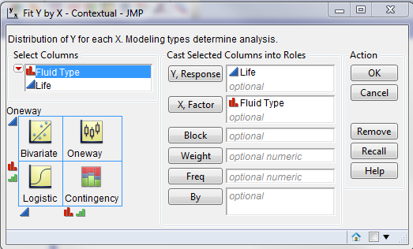
We model it in JMP speak by:

Slide 6
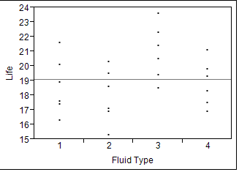
Click on “OK” and first make plot of the data

Slide 7
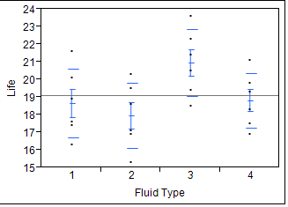
First a Simple Summary Plot:

Slide 8
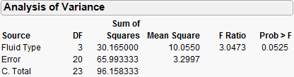
As well as an ANOVA Table:

Slide 9
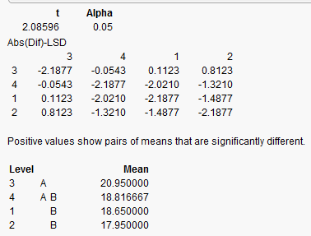
What if we looked at paired t-tests anyway (despite a “large” p-value) to compare means?
Notes:
Comparison-wise error rates

Slide 10
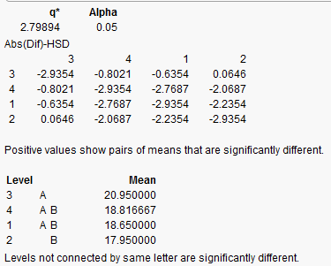
Suppose we used an Experiment-wise Procedure (Tukey is widely used).

Slide 11
So what happened?
Generally do a means comparison only if the F-test is significant, there is a question of logic here.
Even if we ignored logic (I’ve seen it happen) and did the means comparisons, the two procedures do not agree.
The Tukey procedure finds fewer differences.

Slide 12
Comparison-wise vs. Experiment-wise:
Comparison-wise sets alpha for each comparison.
Experiment-wise sets alpha over all comparisons in the experiment.
Remember the Bonferroni Inequality!

Slide 13

Diagnostics (yes we make assumptions)
In order for the tests of significance to be meaningful, it is necessary that our data satisfy certain assumptions regarding the distribution of experimental error. In particular:
We also assume that the experimental error terms are independently and identically distributed (i.i.d. in Statistic 話).
$$\left.ε_{ij}≈Normal(0,σ^{2}\right)$$

Slide 14
Two main diagnostic checks:
Equality of Variances- We check this visually by the appropriate plot(s) and Statistically by a test for equal variances within each Treatment group.
Normality of experimental error terms- We check this visually by a Normality plot (q-q plot) and Statistically by a test for Normality.
Since we don’t know experimental error, we use the residuals as a surrogate since

Slide 15
Equality of variances
It is known from experience that the usual problem with the equal variance assumption is that variances may not be constant over all Trt. groups.
This is usually an artifact of the measurement system such as radio-labeling or PCR.
If there is a problem the variance is usually a function of the Trt. group mean.
Start by plotting Residuals vs. Predicted values.

Slide 16
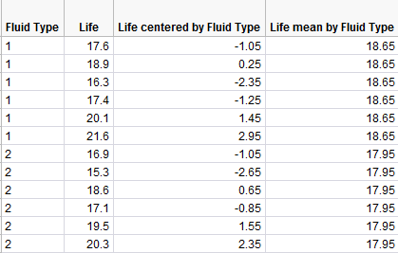
Any ANOVA program will output the Predicted and Residual values

Slide 17
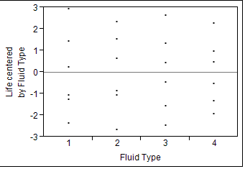
We can plot Residuals vs. Trt group

Slide 18
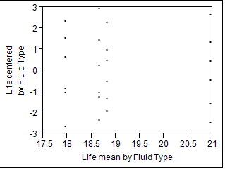
Usually it is Residuals vs. Predicted values which provides the most informative graph

Slide 19

If you can’t see it in the data it’s usually not there, but let’s test variances anyway

Slide 20
As we see a number of tests exist
Bartlett’s and Levene’s tests are commonly used (maybe Bartlett more often).
They almost always give the same answer.
They were designed to test against different possible alternatives to constant variance.
The most common problem is variance increasing with the mean, which is an artifact of many measurement systems.
There are sometimes ceiling or floor effects.

Slide 21
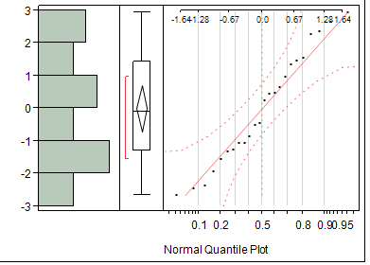
Normality Plots (q-q plots)

Slide 22
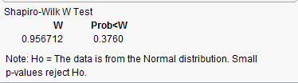
Normality test: Shapiro-Wilk test

