Slide 1
Measurement Analysis
Primary and Derived Measures
Terminology
Prioritization

Slide 2
Fundamental Units
Almost all measurements are made with, or derived from, the Fundamental Units of the SI System. These are:
Meter
Kilogram
Second
Kelvin
Ampere
Candela
Mole
http://en.wikipedia.org/wiki/SI_base_unit

Slide 3
Meter
Unit of length - meter
The meter is the length of the path travelled by light in vacuum during a time interval of 1/299,792,458 of a second.

Slide 4
Kilogram
Unit of mass – kilogram
The kilogram is the unit of mass; it is equal to the mass of the international prototype of the kilogram.

Slide 5
Second
Unit of time – second
The second is the duration of 9,192,631,770 periods of the radiation corresponding to the transition between the two hyperfine levels of the ground state of the cesium 133 atom.

Slide 6
Ampere
Unit of electric current - ampere
The ampere is that constant current which, if maintained in two straight parallel conductors of infinite length, of negligible circular cross-section, and placed 1 meter apart in vacuum, would produce between these conductors a force equal to 2 x 10⁻⁷ newton per meter of length.

Slide 7
Kelvin
Unit of thermodynamic temperature – kelvin
The kelvin, unit of thermodynamic temperature, is the fraction 1/273.16 of the thermodynamic temperature of the triple point of water.

Slide 8
Mole
Unit of amount of substance –mole
1. The mole is the amount of substance of a system which contains as many elementary entities as there are atoms in 0.012 kilogram of carbon 12; its symbol is "mol."
2. When the mole is used, the elementary entities must be specified and may be atoms, molecules, ions, electrons, other particles, or specified groups of such particles.

Slide 9
Candela
Unit of luminous intensity – candela
The candela is the luminous intensity, in a given direction, of a source that emits monochromatic radiation of frequency 540 x 1012 hertz and that has a radiant intensity in that direction of 1/683 watt per steradian.

Slide 10
Historical context
https://en.wikipedia.org/wiki/International_System_of_Units

Slide 11
Derived Units
From the Fundamental Units are obtained the Derived Units which include among many others:
Square meter
Hertz
Meter per Second
Watt
Volt
Ampere per Meter
Lumen,etc.
http://en.wikipedia.org/wiki/SI_derived_unit

Slide 12
Primary Reference Standards
For purposes of international and domestic commerce, all advanced industrial countries have a governmental organization which is responsible for maintaining the Primary Reference Standards of the SI System. In France it is the Bureau International des Poids et Mesures. In the United States, the organization is the National Institute of Standards (NIST) in Gaithersburg, VA. In India it is the Bureau of Indian Standards (BIS), in China it is the Standardization Administration of the Peoples Republic of China (SAC), in Britain it is the British Standards Institution.

Slide 13
Hierarchy of Standards
Owing to the technology required to maintain the Primary Reference Standards, a hierarchy of standards exists to relate the SI system units to the plant floor. The hierarchy is:
Primary Reference Standards (maintained by NIST).
Transfer Standards.
Working Standards.
Instruments and equipment used on plant floor.

Slide 14
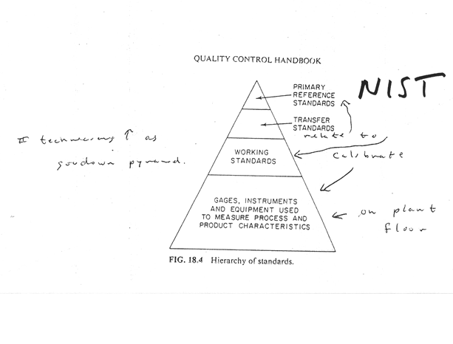
Pyramid of Standards

Slide 15
Hierarchy of Standards, cont.
As we move up or down the Hierarchy of Standards, there is a trade-off in terms of cost and the “accuracy” of the measurements.
A measurement at the top of the hierarchy (NIST), is the most “accurate” but the most technologically difficult and expensive.
A measurement at the bottom of the hierarchy (the plant floor) may be the least expensive, but we are giving up some level of “accuracy”.

Slide 16
Traceability
A great number of organizations are contractually required to, or require their suppliers to, maintain a measurement system that is Traceable to National Standards.
In particular, many Quality System Certifications, such as ISO, have this requirement.

Slide 17
Traceability to National Standards
Traceability requires the establishment of an unbroken chain of comparisons to stated references. NIST assures the traceability of results of measurements or values of standards that NIST itself provides, either directly or through an official NIST program or collaboration.

Slide 18
Unbroken Chain of Comparisons
Here taken to mean the complete, explicitly described, and documented series of comparisons that successively link the value and uncertainty of a result of measurement with the values and uncertainties of each of the intermediate reference standards and the highest reference standard to which traceability for the result of measurement is claimed.

Slide 19
How to make the comparisons?
A comparison between measurements made by different devices is Calibration.
The device with known accuracy is referred to as the standard.
Calibration is one of the areas of Metrology.
Metrology is the science of measurement.
“Traceability, accuracy, precision, systematic bias, evaluation of measurement uncertainty are critical parts of a quality management system.” (Wikipedia Metrology page).

Slide 20
Measurement Terms and Definitions
In order to clearly understand the tradeoffs, we must carefully define various aspects of the measurement process.
Accuracy is the deviation of the measured value from the true value.
Precision is related to the deviation of a group of repeated measurements from a mean value.
While accuracy and precision are often used interchangeably, accuracy relates more to the true value, while precision relates more to consistency.

Slide 21
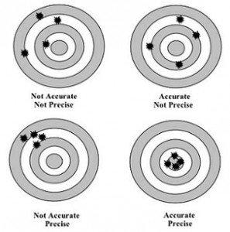
Accuracy and Precision

Slide 22
Terms and Definitions, cont.
Repeatability refers to the measurement variation obtained when one person repeatedly measures the same item with the same gage.
Reproducibility refers to the variation due to different operators using the same gage measuring the same item.
Stability refers to the variation of measurement averages over time.

Slide 23
Importance
Accuracy of a gage can affect our idea of how close our process mean is to our target value, “τ “.
Repeatability and Reproducibility can affect our estimate of Common Cause Variation, Sigma(X).
All three of these affect our estimate of the Capability of the process,
All three of these also contribute to our estimate of the Taguchi loss function,

Slide 24
Estimated Common Cause
Our estimate of Common Cause Variation, which is the variance of the actual product measurement, is actually the sum of three components:
The true product variation.
Variation due to different operators (reproducibility).
Variance of measurement equipment error (repeatability).

Slide 25
Measurement Component Analysis
We can decompose our estimate of Common Cause variation with the following equation.
The individual terms are defined on the following slide.

Slide 26
Notation
Components of Common Cause variation are denoted
by:
= variation of actual product measurement,
= variation of true product characteristic,
= variation due to operator (reproducibility),
= variation due to error (repeatability).

Slide 27
Prioritization of Effort
By analyzing measurement components of Common Cause, we can see where to invest our efforts.
If “true” variation of product is too large, then we invest in the Production Process.
If the variation due to operator is too large, we invest in Training.
If variation due to error is too large, we invest in Measurement Equipment.

