Slide 1
Individuals Charts
Plotting Individual values from subgroups. Subgroups may have “logical” size=1.

Slide 2
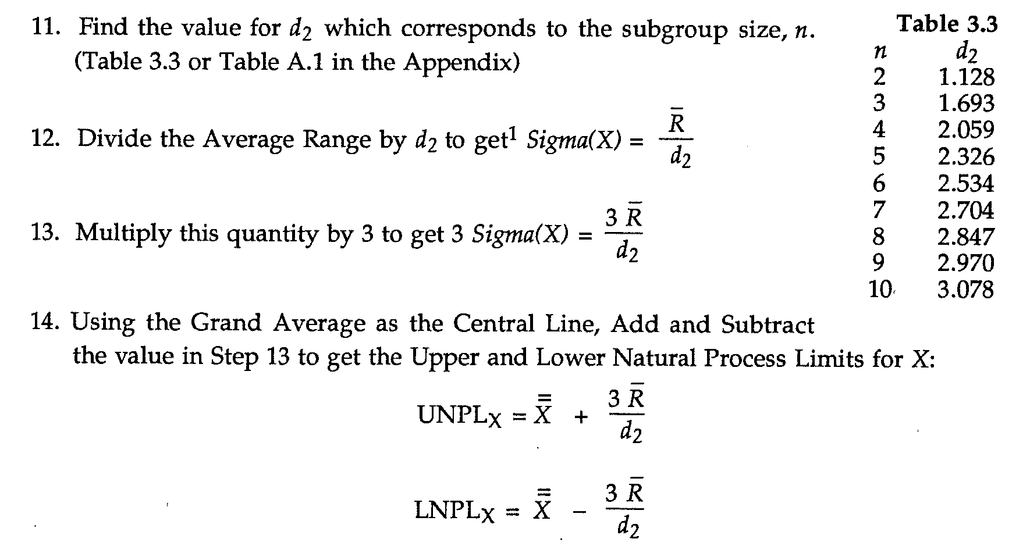
Constructing Individuals Charts

Slide 3
What are the three sigma limits for different charts?
The three sigma limits for X-Bar charts are determined by the standard deviation of the individual X-bar values.
This value is
/
For the plotted values on the X-bar Chart.

Slide 4
Three sigma limits and
Three sigma limits for X-bar are obtained by approximating three sigma over root n by:
We can also estimate Common Cause for a single observation by
So that

Slide 5
Production is uniform within Batch
Example 3.4:
Chemicals are produced and shipped in single railcar tankers. The chemical is uniform (within measurement error) within each rail car. In this case the appropriate estimate of Common Cause will come from successive railcars. The appropriate chart is an XmR chart.

Slide 6
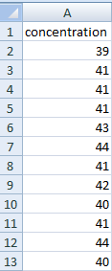
Simple data structure

Slide 7
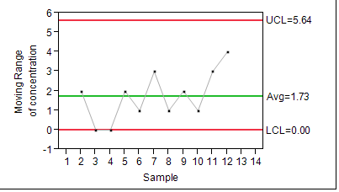
Moving Range Chart (n=2)

Slide 8
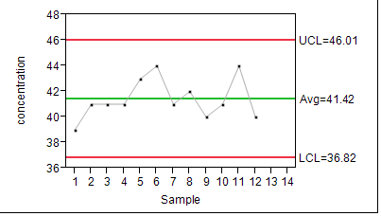
X chart (a.k.a. Individuals chart)

Slide 9
What would happen if….
Joe Blow decided that he would take five samples from each rail car, measure each one, and then use the five values he got for each railcar in 12 subgroups.
i. What would Joe’s R chart likely look like?
ii. How would Joe’s X-bar chart compare to the X chart we saw before?
iii. What about the limits?

