Slide 1
Improving Stable Processes
Professor Tom Kuczek
Purdue University
Using process knowledge to identify uncontrolled variables and control variables as inputs for Process Improvement

Slide 2
Process may be off Target or Have Excess Variation
X-double bar is the estimate of the process mean which may be off target.
Sigma(X) is the estimate of Common Cause Variation.
Both of these contribute to the Capability of the process, .

Slide 3
Improving Common Cause
Common Cause variation usually cannot be reduced by trying to explain differences between values when the process is stable.
How Uncontrolled variables and Control variables affect our response X, must be understood in order to partition Common Cause Variation into basic sources.
Stable processes will require some degree of change to reduce Common Cause.

Slide 4
Variables in the Production Process
Variables in the production process may be Uncontrolled variables or Control variables.
Uncontrolled variables are variables which may affect the output of the process, but which are not currently controlled (such as input Rate to a Process).
Control variables are variables such as process settings which affect the outcome of the process (such as Temperature and Pressure of a reactor vessel).

Slide 5
Output Variables
Output Variables are measurements of the resulting product characteristic, X.
The chosen measures for the product are measures of the product characteristics important to the customer.
Customers may be internal or external to the organization.

Slide 6
Part I: Reducing Output Variation Around the Target
Output variation of the product may be broken down into two sources:
Actual variation of the “true” product characteristic, often around a target value, usually designated by the symbol tau “ τ “.
Variability in the measurement process, which may introduce bias or added variation to the measurement of the characteristic, which occurs in the measurement process itself.

Slide 7
Product Characteristic Variation:
Parameter Design (finding Control settings)
Let us first concentrate on the product characteristic value of interest to our customer. There are two main issues here:
1. To center our product as close to the target value , τ , as possible.
2. To minimize the variation around the target value.

Slide 8
Building an empirical Model
Variables which can affect the output variable, X of the Production Process are either Uncontrolled variables or Control variables.
Uncontrolled variables would include variation in raw materials or environmental conditions during process operation. They are also called Noise variables.
Control variables would include any fixed settings for machines involved in the production process.

Slide 9
Model Form
The model would express product output Y, as a function of uncontrolled and control variables in a form such as:
X= f (uncontrolled variables, control variables)
where f( , ) generally denotes a simple mathematical function, such a regression model.

Slide 10
For example
Suppose we want to measure a response, X=viscosity.
Suppose X is affected by input variables Temp, Pressure and Rate (of process operation).
Then
X=f(Temp, Pressure, Rate)+ε
Can be approximated by a simple Regression model.

Slide 11
Model Building
In order to build even the simplest model for the output characteristic, X, we need a set of data with the values of the uncontrolled and control variables and the resulting output measure X. We may use either:
Exploratory data analysis using existing data to begin with, or
Experimental design, where we use pre-determined values of the uncontrolled variables (temporarily fixed for the experiment) and control variables to give us an optimal model.

Slide 12
Choosing Parameter Levels
Control variables- levels (settings) of control variables are chosen which span available operating settings.
Uncontrolled variables- levels are chosen and temporarily fixed for each of the uncontrolled variables. These levels are chosen to represent values of the uncontrolled variables actually observed during the production process.

Slide 13
Why Control and Uncontrolled Variables?
Uncontrolled variables contribute to the response and therefore contribute to our estimate of Common Cause variation.
Certain settings of the control variables may minimize the effect of the uncontrolled variables, thereby reducing Common Cause, if there is an Interaction between control and uncontrolled variables.
Another control variable can be used to control the mean of the process and so can be used to put the mean near Target.

Slide 14
Why interaction?
If variables interact, we can use control variables to compensate for the variation in uncontrolled variables, such as Rate of input to the process.
Now we can compensate for things we can’t control, like Rate variability, using things we can control, like the process settings for Temp and Pressure.

Slide 15
Forms of Interaction
Interaction can take many forms, but two of the most common and important are antagonism and synergy.
Antagonism occurs when two variables tend to cancel each other out.
Synergy occurs when two variables tend to have a multiplicative effect.

Slide 16
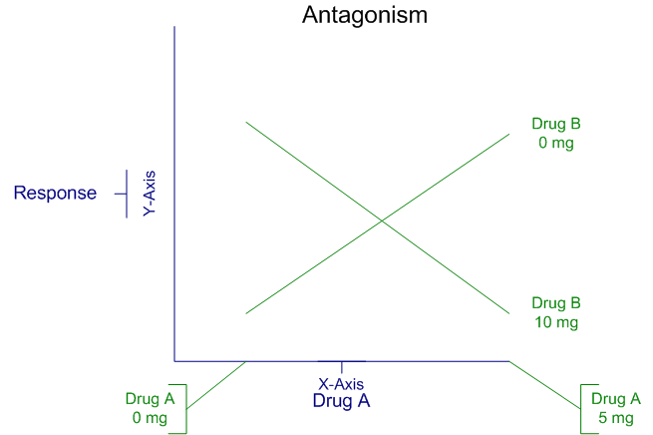
Interaction as Antagonism

Slide 17
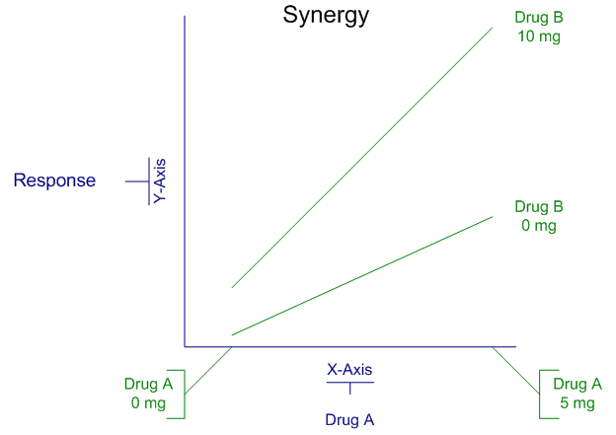
Interaction as Synergy

Slide 18
Response Surface Approach
Goals:
Model the response, X, as a regression-type function of the control and uncontrolled variables.
Use recorded data on the distribution of the uncontrolled variables to model the mean and variance of the response, X.
Pick optimal control variable settings to put the process mean on target and minimize the variation due to uncontrolled variables.

Slide 19
Example continued..
Let us suppose that we have two control variables:
Temp, Pressure - Control
and one noise variable:
Rate - Uncontrolled.
We then fit a slightly more complex equation than simple linear regression to our data. In this model we include an interaction term.

Slide 20
Example, continued…
Assume our fitted model is now
Now that we have two control variables and one of them interacts with the uncontrolled variable Rate, we can use them separately. We can use one of them, Pressure, to minimize variation of the process, while we then use the other, Temp, to then adjust the mean to where the target is.

Slide 21
Example, continued.
We do this by estimating
and
We can set Pressure to minimize the variance and set Temp to put the mean on target.

Slide 22
Steps summarized
For a given output variable X, choose input variables which affect it (Flowmap and C&E Matrix).
Collect data on all variables.
Fit a simple empirical model, such as a Regression model to the data.
Estimate the variability of uncontrolled variables.
Pick Process setting values of control variables to put process mean on target and minimize effect of uncontrolled variable.

Slide 23
BTW, sometimes this works well to reduce Common Cause and sometimes not.
Sometimes this approach does not work well, i.e. you may not be able to use Control variables to reduce the variability that Uncontrolled variables add to Common Cause. If the fitted model does not include an Interaction term you can only adjust the mean of the Process.
When it does work, it is because an Interaction term in the fitted model allows you to reduce Common Cause variation and it is very much like the example shown.

