Slide 1
Gage R&R
Estimating measurement components
Gage capability and acceptability measures
Prof. Tom Kuczek, Purdue Univ.

Slide 2
Terms and Definitions
•Repeatability refers to the measurement variation obtained when one person repeatedly measures the same item with the same gage.
•Reproducibility refers to the variation due to different operators using the same gage measuring the same item.

Slide 3
Estimated Common Cause
Our estimate of Common Cause Variation, which is the variance of the actual product measurement, is actually the sum of three components:
• The true product variation.
• Variation due to different operators (reproducibility).
• Variance of measurement equipment error (repeatability).

Slide 4
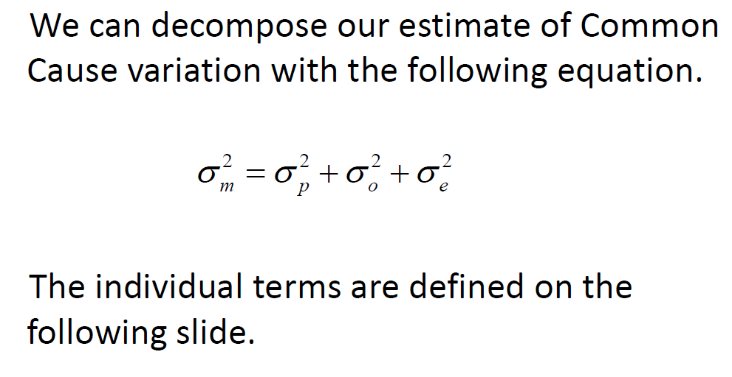
Measurement Component Analysis

Slide 5
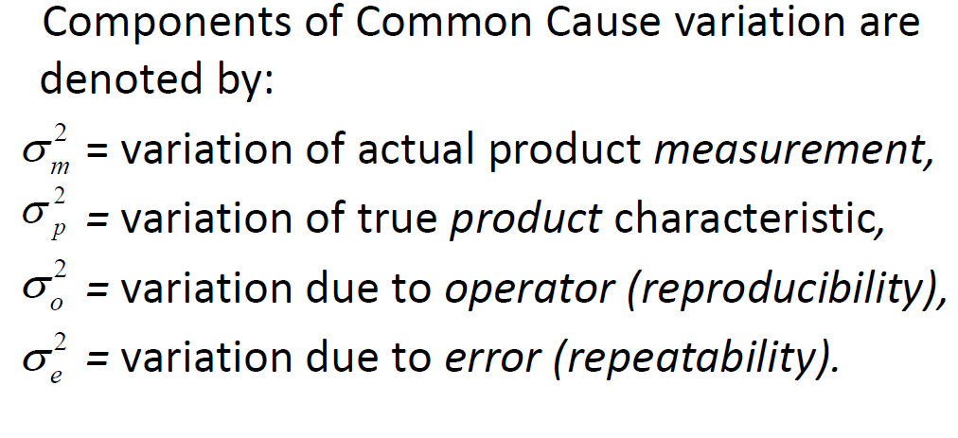
Notation

Slide 6
Gage R&R: Designed Data Collection
In order to estimate these components of variation, we do a standard Gage R&R study. All such studies follow the following format:
We select a fixed number of parts.
We select a fixed number of operators.
Each operator measures each of the parts a fixed number of times.

Slide 7
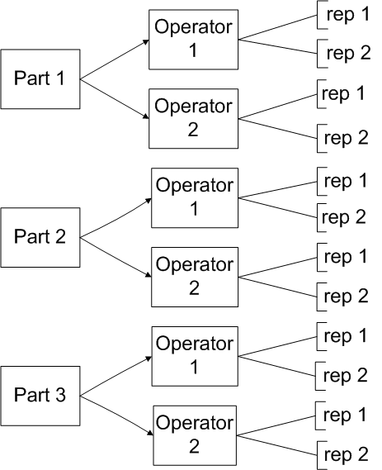
Layout of Typical Gage R&R Study

Slide 8
Analysis of Gage R&R Study Data
There are two typical Statistical tools for the analysis of the data from Gage R&R studies:
The first, and most widely taught technique, is the analysis of average Ranges.
Ranges are obtained from successive replications to estimate error variance.
Ranges from averages between different operators for the same part are used to estimate operator variation.

Slide 9
Analysis of Variance for Gage R&R
The Analysis of Variance (ANOVA) can also be used to analyze Gage R&R studies.
In ANOVA terminology, most Gage R&R studies have an ANOVA type data structure.
A variance component analysis can easily be done in most software packages.
The individual variance components provide estimates of error, operator and “true” product variance.

Slide 10
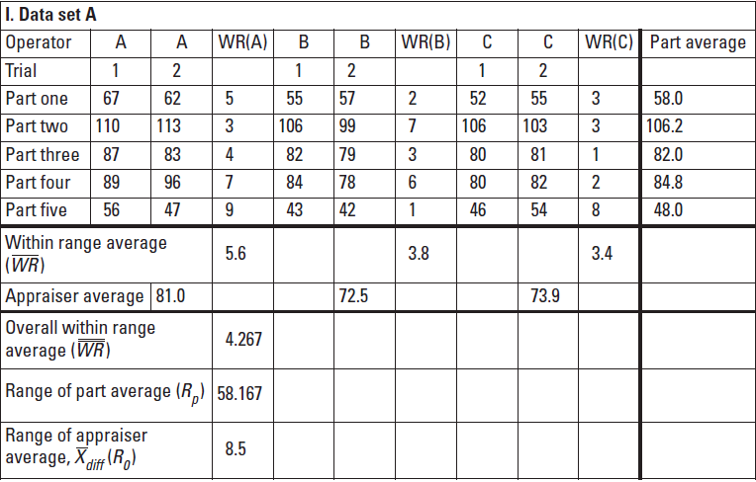
Typical example

Slide 11
Variance components of Model 1

Slide 12
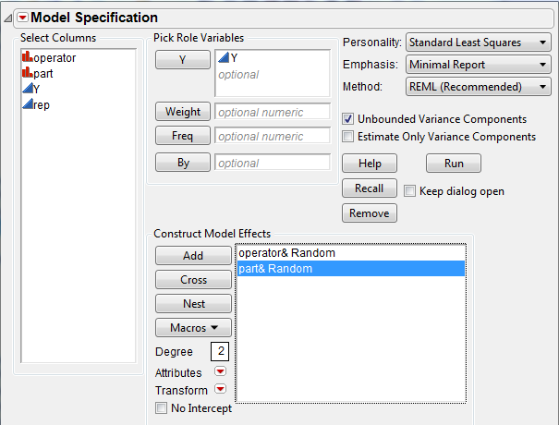
ANOVA of previous example in JMP

Slide 13
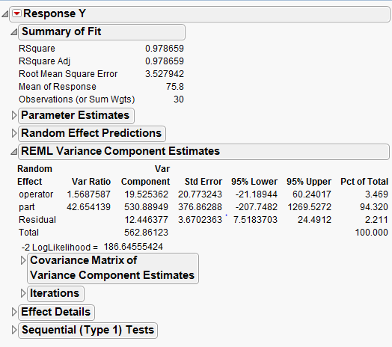
Variance components from ANOVA

Slide 14
Variance components
Part has variance
Operator has variance
Repetition within Part Operator combination has variance

Slide 15
Variance component estimates from Analysis of Variance

Slide 16
Variance Component model 2
This includes an interaction term. In practice, most Analyses use model 1.

Slide 17
Model 2 variance components
The variance components will include a term for the interaction of operator and part.
For Model 2, Reproducibility will be
Reproducibility=

Slide 18
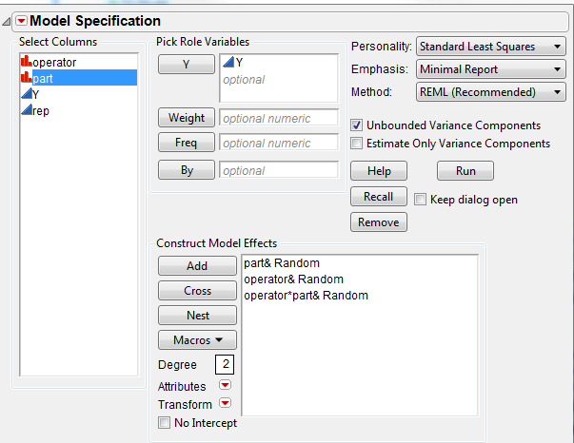
Running model 2 in JMP

Slide 19
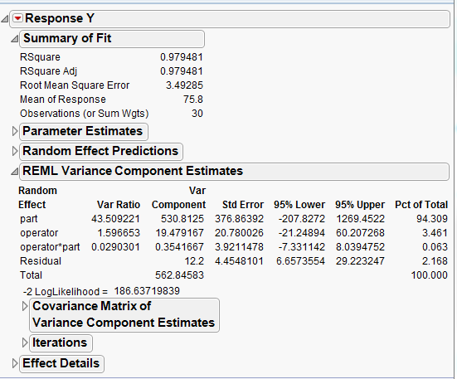
Variance component estimates for Model 2

Slide 20
Model 1 vs. Model 2
An F-test (not shown) shows that the Operator*Part term is not significant at alpha =.10 (authors criteria), then we will use the results of Model 1.
Operator*Part is rarely significant. As a result many people leave it out in practice.

Slide 21
Conclusions from Gage R&R
Part has the greatest variability
Operator and repetition are negligible
Invest in the Process
The Measurement system here is not an issue in the sense of Reproducibility and Repeatability
Concentrate on the Process, put on Target with Minimum Variation

Slide 22
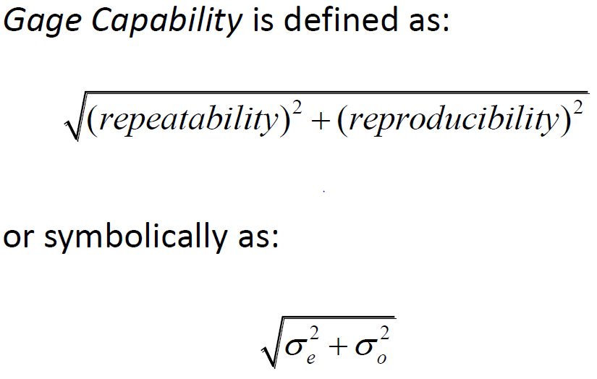
Gage Capability

Slide 23
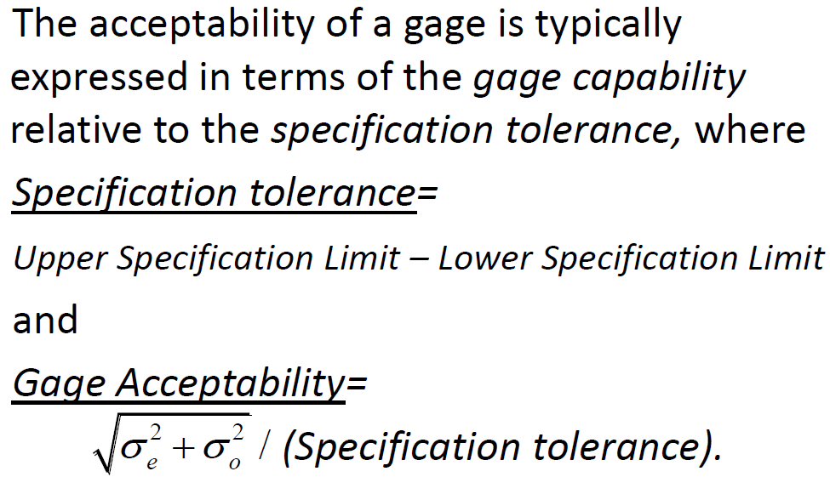
Gage Acceptability (usually specified by contract as a numerical value)

Slide 24
Precision to Tolerance ratio
The Gage Precision to Tolerance ratio is generally defined as
P/T =
Where for our example
P/T < .1 is generally considered acceptable by the author.

