Slide 1
Effective use of Attribute Charts
Disaggregating data

Slide 2
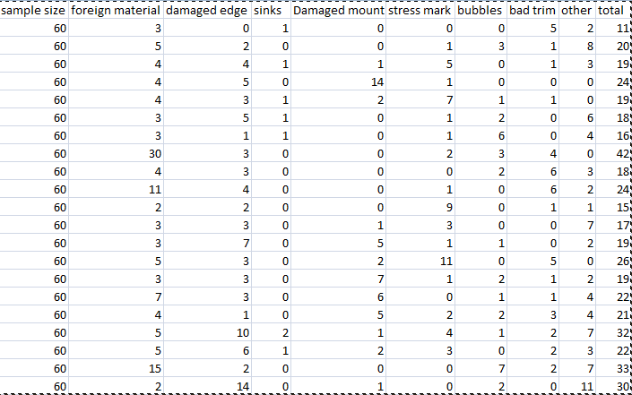
Example 11.2 data

Slide 3
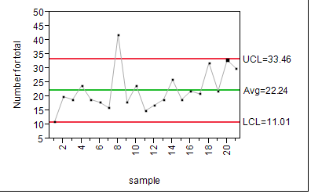
NP Chart of Total Defects

Slide 4
Insensitivity in Chart
Each X value plotted was a sum, i.e.
where
etc.

Slide 5
What is Common Cause for X?
Assuming that different defects occur independently, Sigma(X) can be thought of as
where

Slide 6
What happens to Signals of Special Cause?
What would happen to a signal of Special Cause for defect 1 if all other defects were just reflective of Common Cause?
Where else did we encounter this problem?
How can this be resolved in each case?

Slide 7
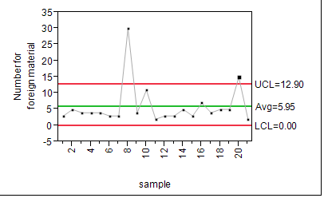
Disaggregating the data

Slide 8
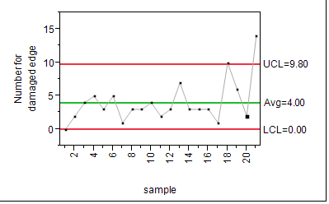
Now Damaged Edge

Slide 9
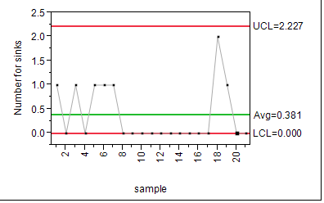
Sinks

Slide 10
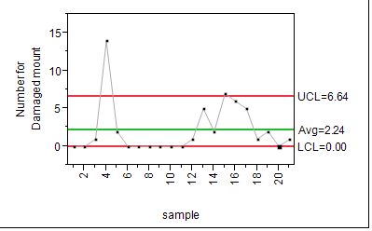
Damaged Mount

Slide 11
You get the idea
Moral of the story, do not combine different non-conformities!!!

