Slide 1
Effect of Measurement Error on SPC

Slide 2
subgroup weight time
1 3 1
1 -3 2
1 -2 3
1 2 4
1 -4 5
2 -6 6
2 -2 7
2 -5 8
2 -2 9
2 5 10
3 5 11
3 3 12
3 2 13
3 6 14
3 2 15

Slide 3
Consider the following Control Charts
R-chart
X-bar chart

Slide 4
Suppose that some measurement error was added to the data?
Our data should be more “variable”
Our estimate of Common Cause variation should increase
It affects the variability of our plotted data
It affects the upper and lower control limits
It obscures Special Cause

Slide 5
As expected it hides Special Cause

Slide 6
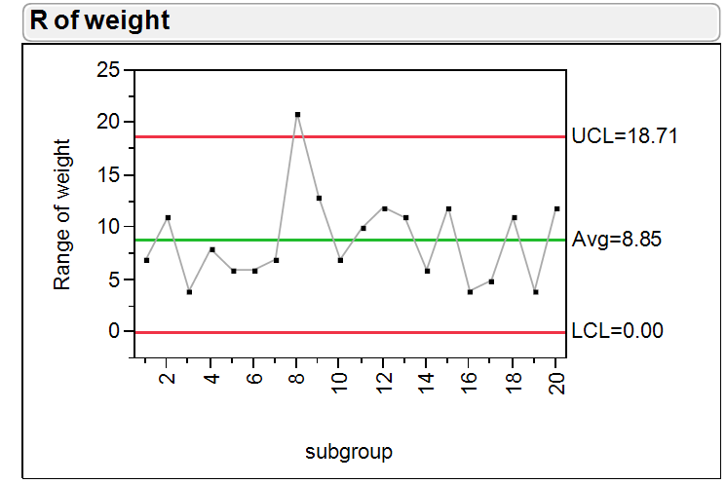
Side by side R-charts

Slide 7
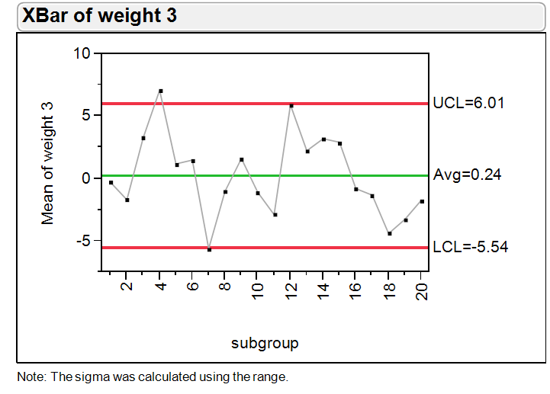
Side by side X-bar charts

Slide 8
What about Capability?

Slide 9
Summary
Increased Measurement Error will widen Control Limits.
Will tend to hide Special Cause when present.
Will increase our estimates of Common Cause, σ_{c}
Will reduce our estimates of Capability indices.

