Slide 1
Attributes Data
Binomial and Poisson Data

Slide 2
Discrete Data
All data comes in Discrete form.
For Measurement data, in principle, it is on a continuous scale, but in reality it is truncated.
As long as Sigma(X)>measurement unit, there is no problem with using charts.
Count data, which occurs when counting Attributes, is discrete since we are restricted to Natural Numbers (0, 1, 2,…etc.).

Slide 3
Binomial Data
In SPC, Binomial Data usually arises when we count the number of items with a certain attribute, usually the number of “defectives”.
Parts are tested and are either defective or not (sometimes called “non-conforming”).
In a sample of size n, we count the number of defectives.
X=# of defectives in our sample, is our data.

Slide 4
If we have a Stable Process
We can assume:
Probability of a defective =p.
Sample size is n. For Binomial data, this is referred to as the “Area of Opportunity”
For all parts p is the same.
Parts are defective or not independently of each other.

Slide 5
Binomial Distribution
If our data satisfies those assumptions then our data, X, has a Binomial Distribution, i.e.,

Slide 6
Mean and Standard Deviation
The mean and standard deviation of X are:

Slide 7
Example, p=.10, n=100

Slide 8
For simulated values:

Slide 9
For Binomial data the sample size, or Area of Opportunity, may vary
If the sample size is constant, then we can use an np-Chart since the Center Line will be a constant.
If the sample size is not constant, then an np-Chart will have a non-constant centerline which makes the chart difficult to interpret.
If we convert our data to sample proportions, the centerline is a constant, though the control limits are variable.

Slide 10
Sample Proportions used when the Area of Opportunity is not constant.
The sample proportion is:
where
and

Slide 11
Centerline and Control Limits
Since we do not know the true value of p, we approximate it by using p-bar which will be the centerline for the p-chart, and for control limits we have

Slide 12
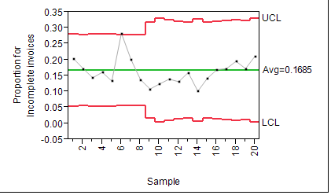
We can plot the p-bar values with three sigma limits on a control chart.
JMP with Example data:

Slide 13
When n is in the thousands:
If n is in the thousands then almost no chart will show statistical control due to the tight limits since
is so small. In this case an XmR chart gives a more reasonable estimate of Common Cause.

Slide 14
Examples where the attribute is not a defect
Suppose you are examining order types (say categories of books) for Amazon. You may be interested in the proportion of children’s books by month.
You work for Menards and you want to look at the proportion of appliance orders by type by month.
These proportions may vary naturally by month so should be included in Common Cause which an XmR chart will do.

Slide 15
Poisson Data
Sometimes the product comes in units of length or area. In this case the non-conformities are counts which may be 0, 1, 2,… which is different than Binomial Data where each item had a binary response. If the product can be considered an area for sampling purposes and the scattering of non-conformities can be considered “random”, then the data fits a Poisson Distribution.

Slide 16
Poisson Distribution
The number of counts, X, of non-conformities in a unit is said to have a Poisson distribution with parameter lambda if

Slide 17
Mean and Standard Deviation
The mean and standard deviation of X are given by:
E(X)=
and
Sigma(X)=

Slide 18
Assumptions
For data to be Poisson, it must satisfy some assumptions (we state in terms of area).
Data is 0, 1, 2, …
The Expected number of counts in any area is proportional to the area size.
The number of counts in any two disjoint areas are statistically independent.
Probability theory then shows it must have the Poisson distribution.

Slide 19
Control charts for Poisson Data
If the area sizes from which we take counts are all equal in size, that is, the Area of Opportunity is equal, then we may plot our sample data
on a control chart called a c chart (yes, c is for counts).

Slide 20
Poisson data for lambda=20

Slide 21
Poisson data for lambda=5

Slide 22
Now let lambda=2.5

Slide 23
If lambda “large enough”
If lambda is 20 or more the distribution is very symmetric and almost normally distributed and we can use three sigma limits in order to create a control chart.

Slide 24
Control limits for c chart
We can get approximate limits for the c chart by using estimates of lambda since
and so three sigma limits should be

Slide 25
Often the Area of Opportunity is not constant so we need to convert our data to rates
If the area of opportunity is not constant we convert the counts to rates by dividing the counts by the area of opportunity and must use a u chart.

Slide 26
Centerline and control limits
The centerline is given by u-bar which is the average rate per unit area
with control limits

Slide 27
JMP sample data set u-chart

Slide 28
Area of Opportunity and Control Limits
For both the p-chart and u-chart, the Control Limits depend on two things: the rate of defects and the size of the Area of Opportunity.
If the rate is higher, the variability is higher so the limits widen (we exclude the case for Binomial where p exceeds ½).
If the Area of Opportunity is larger the estimate of the rate is better so that the limits are narrower.

Slide 29
What happens when the defect rate is extremely low?
When the defect rate is extremely low for Binomial or Poisson data, the three sigma limits have two problems with the charts:
The data is so skewed that the limits are not correct.
Any defect may show up as a signal the process is out of control.

Slide 30
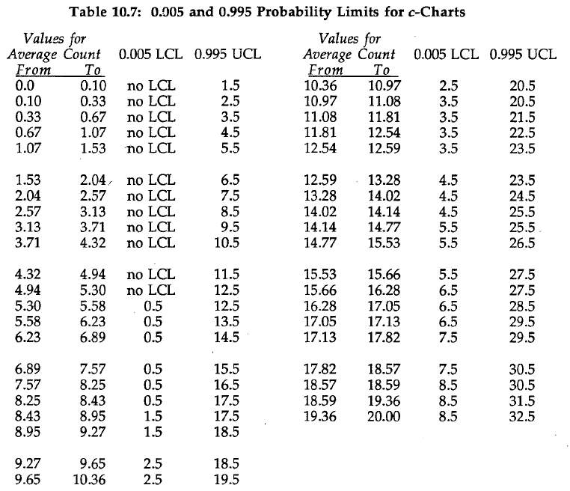
For lamda less than 20

Slide 31
For small lamda, around .01 or less
Any defect will be outside of “exact” control limits.
In this case the control limits will flag any defect as an out of control point. In this particular case, “defect” and “out of control” will coincide.
Any defect will be investigated as Special Cause.
There is no real consensus on this, but low defect rates are a problem anyone would like to have.

